Slide 1
Ensuring quality in crowdsourced search relevance evaluation: The effects of training question distribution
John Le - CrowdFlower
Andy Edmonds - eBay
Vaughn Hester - CrowdFlower
Lukas Biewald - CrowdFlower
Notes:
I am John from CrowdFlower, and we’ll be talking about some methods we used to ensure quality in a crowdsourced search relevance evaluation task.
First some background and motivation.
NEXT

Slide 2
Background/Motivation
Human judgments for search relevance evaluation/training
Quality Control in crowdsourcing
Observed worker regression to the mean over previous months
Notes:
Human Judgments for search relevance evaluation:
Here I want to talk about how the task had been setup to receive the human judgments, and also towards what end are these judgments being collected. Talk about the judgment scale used for the query/product/result pair. Matching/Not Matching/Spam/Off Topic. In this experiment mostly concerned with Matching and Not Matching. ANDY PLEASE TELL ME WHAT TO SAY. It seems we want to show what a judgment task looks like here.
Doing many experiments using these methods over several months, we noticed how workers were responding to the training questions in ways that were adversely affected our results.

Slide 3
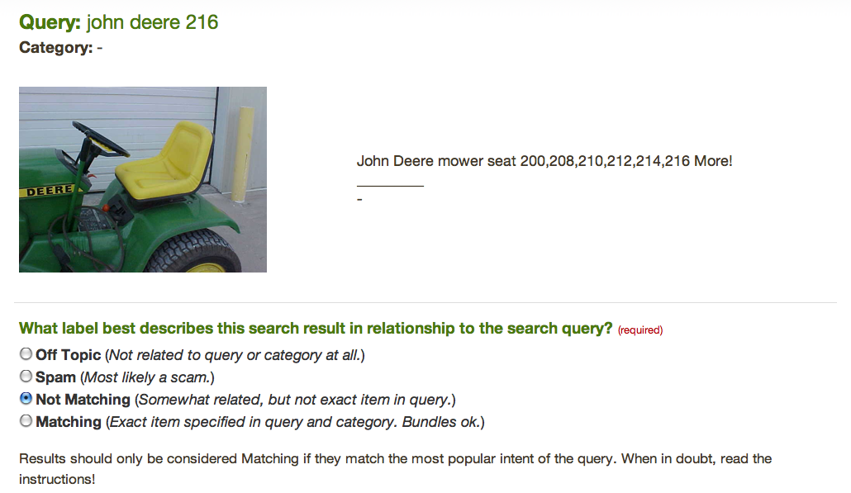
Notes:
Here is an example of what a worker saw in the task
A query, and possibly an associated category in which the query was asked, and then a result.
We ask them to choose which label then best describes the search result in relation to the query.
The four labels are Off Topic Spam Not Matching And Matching
Off topic are results that are not related to the query at all and should not be in the query result.
Spam represents a result that likely indicates a scam.
Not matching indicates a result which does not match what you want given your query. In this case the query is for a john deere 216 lawn mower. Even though the result has john deere 216 in the result string, The result is not matching because it is for a lawn mower seat and not a lawn mower.
This would be a matching query if the result was the actual lawn mower.
For this task, we realize that quality control is essential for the success of crowdsourcing these judgments.

Slide 4
Our Techniques for Quality Control
Training data = training questions
Questions to which we know the answer
Dynamic learning for quality control
An initial training period
Per HIT screening questions
Notes:
We do this in a couple of ways.
First we gather a set of training questions, questions to which we know the answer. We will embed this in our task as follows.
Particularly providing a dynamic learning environment where workers first see
an initial training period where workers only see questions to which we know the answer (training questions).
The worker must answer at least 4 query sets correctly before continuing. If they are unable to correctly answer 4 query sets after doing at least 12 query sets, they are removed from the task and prevented from continuing, they will also not be paid.
Throughout the rest of the task we insert a set of periodic screening / ringer questions in each assignment. Similarly using the training questions.
When users get the training questions wrong we notify them of the error, telling them the correct answer, as well as telling them why our answer is correct.
A worker is removed from the task if they perform too poorly on the training questions.
- can get a better feel for this by visiting the link mentioned in our paper.

Slide 5
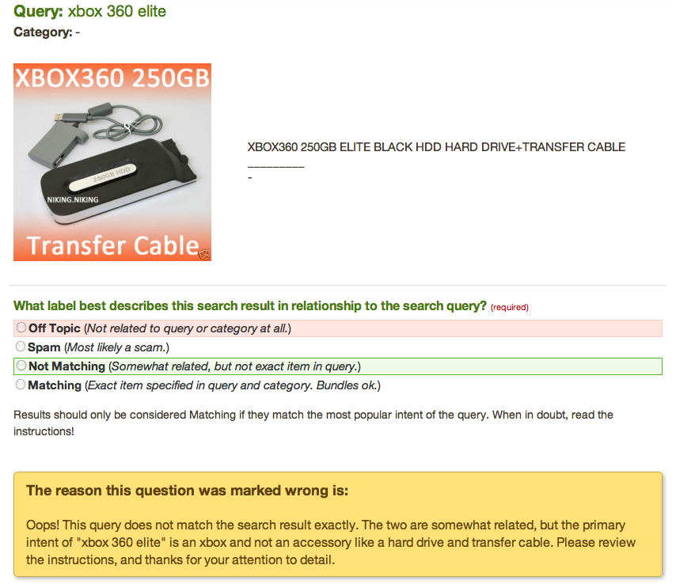
Notes:
Here is an example of what a worker sees when they incorrectly label a result according to our standards.

Slide 6
Contributions
Questions explored
Does training data setup and distribution affect worker output and final results?
Why important?
Quality control is paramount
Quantifying and understanding the effect of training data
Notes:
In our paper we attempt to quantify the influence of this dynamic learning environment by examining
how the setup and distribution of correct answers in our training data affect worker output and final aggregate results (aggregated with majority vote)
Quantifying, measuring, and understanding the effects of training environment on:
- How workers can be improved? How can results be improved?
are vital for continued development and improvement of crowdsourcing.
To test this we ran controlled experiments, where we vary the setup of the training questions.
NEXT

Slide 7
The Experiment: AMT
Using Mechanical Turk and the CrowdFlower platform
25 results per HIT
20 cents per HIT
No Turk qualifications
Title: “Judge approximately 25 search results for relevance”
Notes:
These were the parameters of the hits put on Turk. Though at crowdflower, we have many labor channels we only used Turk to minimize variance from other worker channels.

Slide 8
Judgment Dataset
Dataset: major online retailer’s internal product search projects
256 queries with 5 product pairs associated with each query = 1280 search results
Examples:
“epiphone guitar”, “sofa,” and “yamaha a100.”
Notes:
The dataset came from a major online retailer's internal product search projects.
It consisted of 256 queries with 5 product pairs associated with each query.
In other words, the dataset contained 1,280 search results.
There were 164 distinct queries which included product queries such as: “LCD monitor”, “m6600”, “epiphone guitar”, “sofa,” and “yamaha a100.”
NEXT

Slide 9
Experimental Manipulation
Judge Training Question Answer Distribution Skews
Experiment | 1 | 2 | 3 | 4 | 5
Matching | 72.7% | 58% | 45.3% | 34.7% | 12.7%
Not Matching | 8% | 23.3% | 47.3% | 56% | 84%
Off Topic | 19.3% | 18% | 7.3% | 9.3% | 3.3%
Spam | 0% | 0.7% | 0% | 0.7% | 0%
Underlying Distribution Skew
Matching | Not Matching | Off Topic | Spam
14.5% | 82.67% | 2.5% | 0.33%
Notes:
We ran five experiments, one for each of the varying training data distribution skews as seen in the table.
We tried as best as possible to symmetrically vary “Matching” and “Not Matching” results across the experiments.
The same underlying distribution of query result sets were used in each experiment.
The data was previously judged by a set of experts from the online retailer, and we measure our results against these expert judgments.
NEXT

Slide 10
Experimental Control
Round-robin workers into the simultaneously running experiments
Note only one HIT showed up on Turk
Workers were sent to the same experiment if they left and returned
Notes:
We ran a round-robin of workers into the simultaneously running experiments. We posted the HIT in such a way so that only one HIT showed up on Turk.
We stored workers on our servers so that if a worker left and then returned, they would be returned to the same experiment.

Slide 11
Results
Worker participation
Mean worker performance
Aggregate majority vote
Accuracy
Performance measures: precision and recall

Slide 12
Worker Participation
Matching skew
Not Matching skew
Experiment | 1 | 2 | 3 | 4 | 5
Came to the Task | 43 | 42 | 42 | 87 | 41
Did Training | 26 | 25 | 27 | 50 | 21
Passed Training | 19 | 18 | 25 | 37 | 17
Failed Training | 7 | 7 | 2 | 13 | 4
Percent Passed | 73% | 72% | 92.6% | 74% | 80.9%
Notes:
Task design: what metric should I pay attention to.

Slide 13
Mean Worker Performance
Matching skew
Not Matching skew
Worker \ Experiment | 1 | 2 | 3 | 4 | 5
Accuracy (Overall) | 0.690 | 0.708 | 0.749 | 0.763 | 0.790
Precision (Not Matching) | 0.909 | 0.895 | 0.930 | 0.917 | 0.915
Recall (Not Matching) | 0.704 | 0.714 | 0.774 | 0.800 | 0.828
Notes:
Per worker accuracy went up from 1 to 5. This is misleading because the underlying distribution is skewed in this direction.
What we notice is that precision peaks in the the cell where answers were random in other words had maximum entropy.
1 and 5 skewed positive negative respectively.
Highlight a cell so we can see the max precision

Slide 14
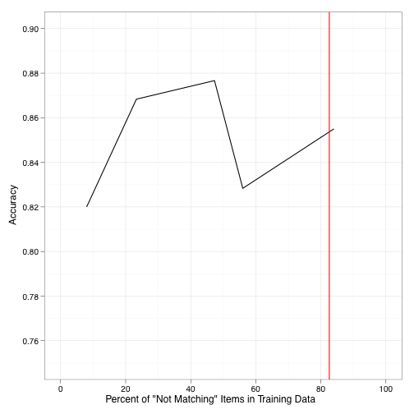
Aggregate Majority Vote Accuracy: Trusted Workers
3
2
5
4
1
Underlying Distribution Skew
Notes:
How confident do I feel about these results?

Slide 15
Aggregate Majority Vote Performance Measures
Matching skew
Not Matching skew
Experiment | 1 | 2 | 3 | 4 | 5
Precision | 0.921 | 0.932 | 0.936 | 0.932 | 0.912
Recall | 0.865 | 0.917 | 0.919 | 0.863 | 0.921
Notes:
Notice that when the skew of the training questions matched the underlying distribution, recall exceeded precision, indicating that workers overall aggregated
Bolding
D-prime

Slide 16
Discussion and Limitations
Maximize entropy -> minimize perceptible signal
For a skewed underlying distribution
Notes:
distribution.
We found that workers yielded greater precision on iden-
tifying \Not Matching" items when they were trained on
a training set with a more uniform distribution of correct
answers. Results aggregated by majority vote had greater
accuracy even though the test set had a skewed distribution
towards \Not Matching" items.
Workers are very adept at realizing that items are heavily
skewed to a certain label (an anchoring eect) and may be
predisposed to select the label with the highest prior. Work-
ers would then be more likely to miss items that deviate
from their expectations. Thus in this learning environment,
training questions should predispose no bias.
This phenomenon may be due in part to workers' ability
to learn testing data as they are exposed to it. Machine-
learned classiers generally cannot learn from test data as
it is processed, which is why it is so important to have ro-
bust training sets. Humans are not machines, so when doing
machine-learning-like tasks where we use humans as classi-
ers, we must apply dierent techniques to train them. Tong
et al [11] noted that incorporating active learning methods in
training machine-learned classiers may oer improvements
to traditional methods. This result may also imply that
strategies for training humans could inform future research
on machine learning algorithms.
This experiment suggests broader implications for prac-
titioners; namely that a dynamic learning environment can
be used strategically to: 1) identify unethical workers and
2) train ethical workers more eectively. However, the at-
tributes of the learning environment are critical. In particu-
lar the choice of training examples will aect worker output.
Further development and application of these principles will
enable us to approach search relevance tasks involving am-
biguous queries or even more complex tasks that require
domain-specic knowledge.
Notes/limitations:We have run this type of task numerous times over the
past year on AMT, and as such workers may have entered
the job with expectations as to what answers allow them
to pass training questions. On previous runs of this task,
items were overwhelmingly \Matching" (about 80%). Be-
cause repeat workers can learn the training data through
repeated exposure, our experiments skewed the distribution
of items towards \Not Matching." We point out that the
training data used for these experiments had not been used
previously on any crowdsourcing platform.
We priced this task at an extremely high rate for an AMT
task. An unusually high price tends to attract many oppor-
tunistic or untrustworthy workers. Part of the goal of this
experiment was to engage a diverse set of both ethical and
unethical workers.
REVIEWER TALKING POINTS:

Slide 17
Future Work
Optimal judgment task design and metrics
Quality control enhancements
Separate validation and ongoing training
Long term worker performance optimizations
Incorporation of active learning
IR performance metric analysis
Notes:
Active Learning
Provide training questions and feedback that take into account the users responses
We shall run more experiments to further validate these
results. Future research should also extend the learning envi-
ronment, possibly by incorporating active learning methods
to train workers on similar examples of items they got in-
correct and by developing a more rened model for estimat-
ing the \true" error rate of workers using a full multinomial
model [10]). Having such a model for worker responses may
better show why workers are getting questions wrong and
may also point to diculty and ambiguity in our task. If we
dierentiate workers by demographics we may also be able
to identify cultural differences, which could in turn improve
task design.

Slide 18
Acknowledgements
We thank Riddick Jiang for compiling the dataset for this project. We thank Brian Johnson (eBay), James Rubinstein (eBay), Aaron Shaw (Berkeley), Alex Sorokin (CrowdFlower), Chris Van Pelt (CrowdFlower) and Meili Zhong (PayPal) for their assistance with the paper.

Slide 19
Questions?
Thanks!
john@crowdflower.com
aedmonds@ebay.com
vaughn@crowdflower.com
lukas@crowdflower.com

