Slide 1
Insights into Mechanical Turk (or, “Mistakes Requesters Make”)
Adam D. Bradley
abradley@amazon.com

Slide 2
What is Mechanical Turk?
Amazon Mechanical Turk is a marketplace for work.

Slide 3
Feedback
Mechanical Turk provides a set of primitives
HIT properties (reward, instructions, requirements)
Assignment can be approved or rejected
Worker can be bonused
Worker can be blocked
Qualification can be assigned or revoked
You use these primitives to execute your “policies”
Your policies shape your Reputation

Slide 4
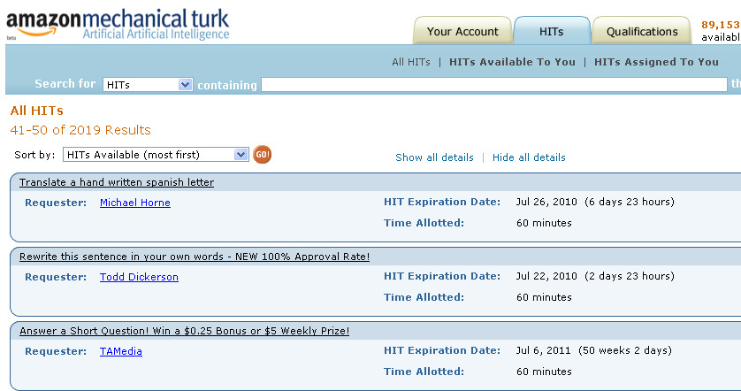
Law of Unintended Consequences is True

Slide 5
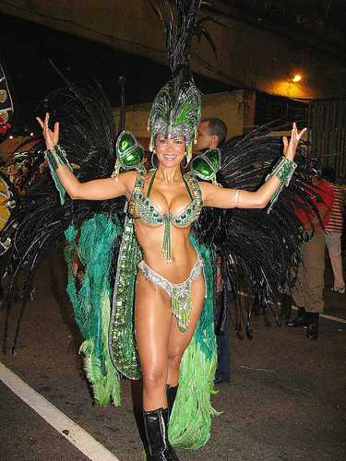
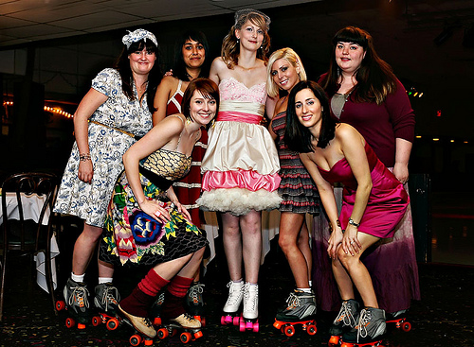
Plurality to the Rescue (?)
Notes:
Your algorithm might be to ask multiple Workers the same question and use matching to validate the answer.
There have been many papers written about this approach. This works well when there is a limited set of answer choices for Workers to choose from.
We asked people to decide whether images are “risque”:
More nudity then you'd see in a PG-13 movie
Naked female breasts on person old enough to walk
Naked buttocks or genitalia on person old enough to walk
Fully or partially clothed but in a seductive or sexually suggestive pose
Our test data was evenly divided between 4 categories: “No people”, “Fully clothed people”, “PG/beach skin”, and “nudity”.
Plurality of 10, 1000 answers back from Workers within 9 minutes.
Of the answers 92% were correct.
What is interesting about these is that MOST (94%) of the non-matching answers were workers miscategorizing “PG” as “risque”.
I’m sure you’ll be able to guess which of these pictures is in the “gray”
If agreement doesn’t happen, what’s your first reaction
“These aren’t good Workers – reject and block” or “just ask another 10” --
http://www.flickr.com/photos/mhayesphotos/4113454839/
http://www.flickr.com/photos/aforum/3028457508/
http://www.flickr.com/photos/aresauburnphotos/3024630428/
http://www.flickr.com/photos/teesha/4424703259/

Slide 6
When Plurality Diverges
Possible Root Causes
Worker skills/training/knowledge
Ergonomics
Worker effort
Ambiguity in the Instructions
Ambiguity in the Data

Slide 7
When Plurality Diverges
Worker Quality and Worker History
1000 questions, 5 answers each = 5000 independent answers
5 Workers each answer 1000 questions
See Ipeirotis et al in HCOMP 2010

Slide 8
When Plurality Diverges
Which Workers do you Trust?
“Gold Standard”, “Ground Truth”, “Trap”
“Meaningful” Sample?
Approval History…?
Is “Trust” closed or open?

Slide 9
Turnaround time for Requester X’s HITs
Notes:
Here is the work turnaround time for a Requester on the system. You’ll notice some big swings in turnaround time from Jan thru April. During these swings they were adjusting their approval/rejection policies. But you’ll notice that once these get established in May timeframe, they start to see very good response times.
In fact they are consistently under 6 minutes starting in June.
How did they build such loyalty?
They paid quickly and consistently. … Let’s look at Workers comments posted during this timeframe…

Slide 10
Turnaround time for Requester X’s HITs
Anyone try out these HITs.
I stopped doing these HITS since the rejection rate has increased tremendously compared to the initial stage
thanks, for telling me about these.
I found my new favorite HIT
I have done about 700 with 5 rejects …. Honestly I feel like my rejects have come from being tired and selecting the wrong answer

Slide 11
Comparison of Turnaround Time
Notes:
This chart shows a steady state comparison of Requester X and a Page 1 Requester (Requester Y)
Most people assume that a “Page 1” Requester like Requester Y would get faster turnaround time.
Requester Y pays slightly more, been in the system much longer.
Requester Y does roughly the same amount of work as Requester X (some months higher, some lower)
Requester Y is consistently on Page 1.
While Requester X is on page 2 or higher. Almost never on page 1.
Many people assume that you have to be on page 1 to get Workers’ attention – maybe at first, but not in steady-state.
Reputation and alternative discovery aren’t immediately visible in our catalog, but they’re visible to Workers
The experience of these 2 Requesters is driven not by what page they’re on, but reputation.
Requester X adjudicates FAST and consistently.
Once Workers buy in, the reputation spreads quickly
TurkerNation, mTurk Forum (reputation, karma, etc)

Slide 12
Optimizing For Best Results
Accuracy
Price
Speed

Slide 13
By the way – We’re Hiring!
turk-jobs@amazon.com

Slide 14
Questions?
abradley@amazon.com

