Slide 1
Crowdsourcing Interactions A proposal for capturing user interactions through crowdsourcing
G. Zuccon, T. Leelanupab, S. Whiting, J. M. Jose, and L. Azzopardi
University of Glasgow, UK
{guido, kimm, stewh, jj, leif}@dcs.gla.ac.uk

Slide 2
Capturing User Interactions
Query (Sessions) logs from search engines
Laboratory based user experiments

Slide 3
Capturing User Interactions
Query logs from search engines:
completely naturalistic

Slide 4
Capturing User Interactions
Query logs from search engines:
completely naturalistic

Slide 5
Capturing User Interactions
Query logs from search engines:
completely naturalistic
inexpensive

Slide 6
Capturing User Interactions
Query logs from search engines:
completely naturalistic
inexpensive

Slide 7
Capturing User Interactions
Query logs from search engines:
completely naturalistic
inexpensive
often infeasible for academic researchers (companies are not inclined to release this info -> privacy concerns)

Slide 8
Capturing User Interactions
Query logs from search engines:
completely naturalistic
inexpensive
often unavailable to academic researchers (companies are not inclined to release this info -> privacy concerns)

Slide 9
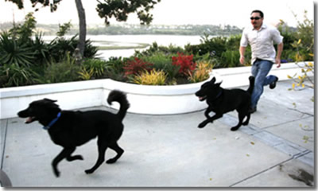
Capturing User Interactions
Query logs from search engines:
completely naturalistic
inexpensive
often infeasible for academic researchers (companies are not inclined to release this info -> privacy concerns)
no control on the user population (or limited)

Slide 10
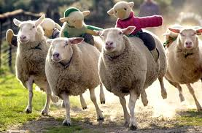
Capturing User Interactions
Query logs from search engines:
completely naturalistic
inexpensive
often infeasible for academic researchers (companies are not inclined to release this info -> privacy concerns)
no control on the user population (or limited)

Slide 11
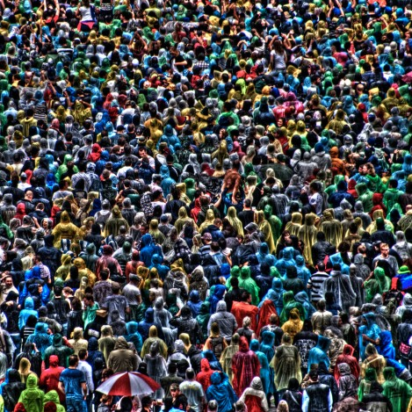
Capturing User Interactions
Query logs from search engines:
completely naturalistic
inexpensive
often infeasible for academic researchers (companies are not inclined to release this info -> privacy concerns)
no control on the user population (or limited)
large number of (often) heterogeneous user interactions

Slide 12
Capturing User Interactions
Query logs from search engines:
completely naturalistic
inexpensive
often infeasible for academic researchers (companies are not inclined to release this info -> privacy concerns)
no control on the user population (or limited)
large number of (often) heterogeneous user interactions

Slide 13
Capturing User Interactions
Laboratory based user experiments:
perform some predefined simulated information seeking task

Slide 14
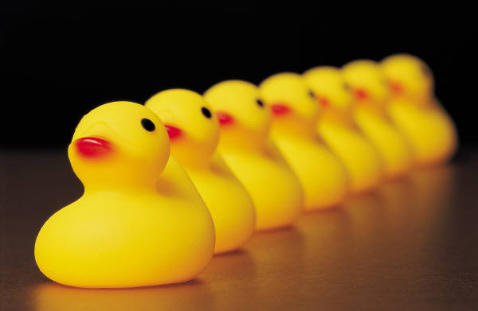
Capturing User Interactions
Laboratory based user experiments:
perform some predefined simulated information seeking task
limited and homogeneous user population

Slide 15
Capturing User Interactions
Laboratory based user experiments:
perform some predefined simulated information seeking task
limited and homogeneous user population

Slide 16
Capturing User Interactions
Laboratory based user experiments:
perform some predefined simulated information seeking task
limited and homogeneous user population
expensive

Slide 17
Capturing User Interactions
Laboratory based user experiments:
perform some predefined simulated information seeking task
limited and homogeneous user population
expensive
collected data << than what is acquired by search engines’ query-logs

Slide 18
Capturing User Interactions
Laboratory based user experiments:
perform some predefined simulated information seeking task
expensive
limited and homogeneous user population
collected data << than what is acquired by search engines’ query-logs
extensive control over the participants

Slide 19
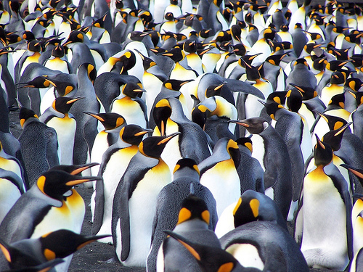
Alternative way for Capturing User Interactions?
Crowdsourcing?

Slide 20
Crowdsourcing Interactions
Use crowdsourcing for getting user interactions:
workers are asked to complete information seeking tasks within a web-based crowdsourcing platform
researchers can capture logs of workers interactions
acquire entry and post-search information and statistics, to characterise user population.
~ similar to lab-based experiments?

Slide 21
Crowdsourcing VS Lab-based Interactions
Key aspects:
Definition of information seeking tasks
How interactions are captured
Post-retrieval information acquisition
Characteristics of user population

Slide 22
Crowdsourcing has an heterogeneous and large user population
Mechanical Turk workers are relatively representative
of the population of US Internet users
See “Demographics of Mechanical Turk”, P. Ipeirotis

Slide 23
Crowdsourcing is cheap
Average hourly rate of experiments we carried on is $1.38
National minimum wage in UK is $9.35.

Slide 24
Quality? (of supplied info, of interacitions)
~ laboratory-based experiments provide to researchers correct and detailed information
What about crowdsourced workers?
malicious users
not motivated
likely optimise working strategy for completing tasks (completion with the minimum effort or within a minimum time)

Slide 25
Typology IIR tasks
Traditional IIR:
creation of simulated work task situations
Read long/numerous instructions
user has to pose himself within the simulated scenario
user is told the specific information need he is expected to satisfy
Applicable to crowdsourced workers?
Need to define a new protocol for performing IIR tasks in crowdsourcing environments?

Slide 26
1. Define Information seeking task
Topic: Warren Moon
The questions:
How many times was Moon a Pro Bowler?
Who have coached Moon in professional football?
List the professional teams for which Moon has been a player

Slide 27
1. Define Information seeking task

Slide 28
2. Capture Interactions
Demo: http://research.alltheway.co.uk/?AssignmentId=123&HitId=123

Slide 29
2. Capture Interactions

Slide 30
2. Capture Interactions

Slide 31
2. Capture Interactions

Slide 32
3. Acquire post-search information

Slide 33
4. Characteristics of user population
Require qualification test:
Quantitatively characterise a user
based on aptitude or Intelligence Quotient (IQ)
this also gives an estimate of whether workers are suitable for the typology of information seeking task

Slide 34
4. Characteristics of user population
Which word is closet in meaning to LIGAMENT?
Band
Nerve
Tendon
Appendage
Branch

Slide 35
Interactions statistics

Slide 36
Warren Moon
Warren Moon Pro Bowler
Warren Moon a Pro Bowler
Warren Moon a Pro Bowler – coach
Warren Moon football
How many times was Moon a Pro Bowler?

Slide 37
Warren Moon
How many times was Warren Moon a Pro Bowler
how many times was moon a pro bowler
Pro Bowler named Moon
Warren Moon
Warren Moon coach
who coached warren moon in professional football

Slide 38
Warren Moon
Warren Moon
who coached warren moon
in professional football
Warren Moon coach
Warren Moon Pro Bowler

Slide 39
In summary (1/3)
Crowdsourced interactions not substitute of lab-based/query logs
but, can be used as additional data

Slide 40
In summary (2/3)
Need to compare crowdsourced interactions with lab-based interactions
Are they similar?
Do correlate?
Differences in user population characterisation?

Slide 41
In summary (3/3)
Crowdsourcing interactions
Crowdsourced IIR systems evaluation?

