Slide 1
Estimating the Completion Time of Crowdsourced Tasks using Survival Analysis
Jing Wang, New York University
Siamak Faridani, University of California, Berkeley Panos Ipeirotis, New York Univesity
1

Slide 2
Crowdsourcing: Pricing and Time to completion?
Many firms use crowdsourcing for a variety of tasks
Still unclear how to price
Prior results indicate that price does not affect quality (Mason and Watts, 2009)
…but it does affect completion time
Unclear how long it will take for a task to finish
2

Slide 3
Data Set: Mechanical Turk Tracker (http://www.mturk-tracker.com)
Crawled Amazon Mechanical Turk hourly (now every min)
Captured full market state (content, position, and characteristics of all available HITs).
15 months of data (now >24 months)
165,368 HIT groups
6,701,406 HIT assignments from 9,436 requesters
Value of the HITs: $529,259 [guesstimate ~10% of actual value]
Missing very short tasks (posted and disappeared in <1hr)
Do not observe HIT redundancy
3

Slide 4
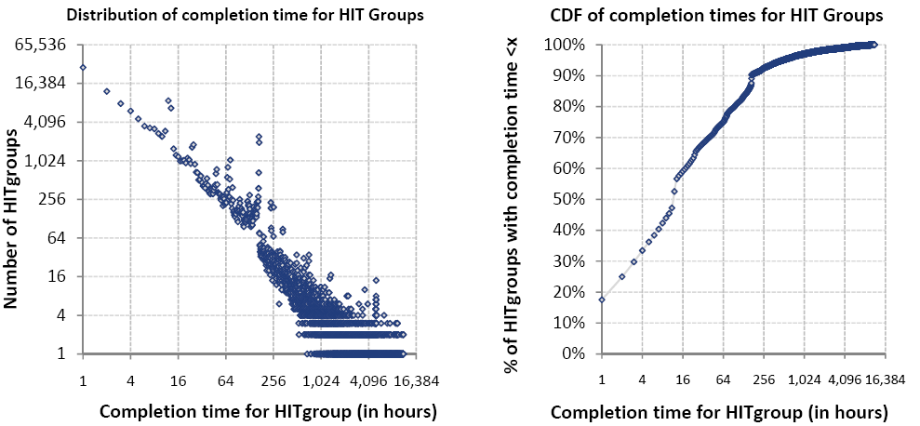
Completion Times: Power-laws
HIT completion time: Time_last_seen – Time_first_posted
4

Slide 5
Completion Times: Power-laws and Censoring
Censoring Effects
Jumps/Outliers: Expiration
Different slope: Requesters taking down HITs
HIT completion time: Time_last_seen – Time_first_posted
5

Slide 6
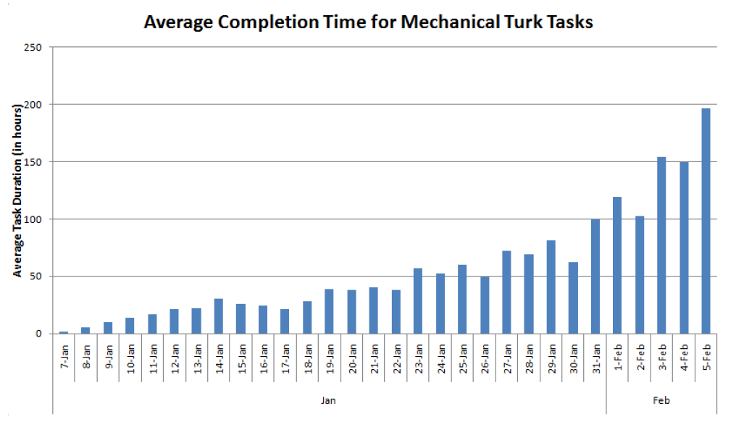
Parameter estimation
Maximum Likelihood Estimation, controlling for censored data
Power-law parameter α~1.5
Power-laws with α<2 do not have well-defined mean value
Sample average increases as sample size increases
6

Slide 7
Why Power-laws?
Queuing theory model by (Cobham, 1954):
If workers pick tasks from two priority queues, completion time follows power-law with α=1.5
Chilton et al, HCOMP 2010: workers rank either by “most recently posted” or by “most HITs available”
Result: Inherent unpredictability of completion time
Real solution: Amazon should change the interface
But let’s see how other factors affect completion time
7

Slide 8
Survival Analysis
Examine and model the time it takes for events to occur
In our case: Event = HIT gets completed
Survival function S(t):
Probability that tasks will last longer than t
Used stratified Cox Proportional Hazards Model
8

Slide 9
Covariates Examined
HIT Characteristics
Monetary reward
Number of HITs
Length in characters
HIT topic (based on Latent Dirichlet Allocation analysis)
Market Characteristics
Day of the week (when HIT was first posted)
Time of the day (when HIT was first posted)
Requester Characteristics
Activities of requester until time of submission
Existing lifetime of requester
9

Slide 10
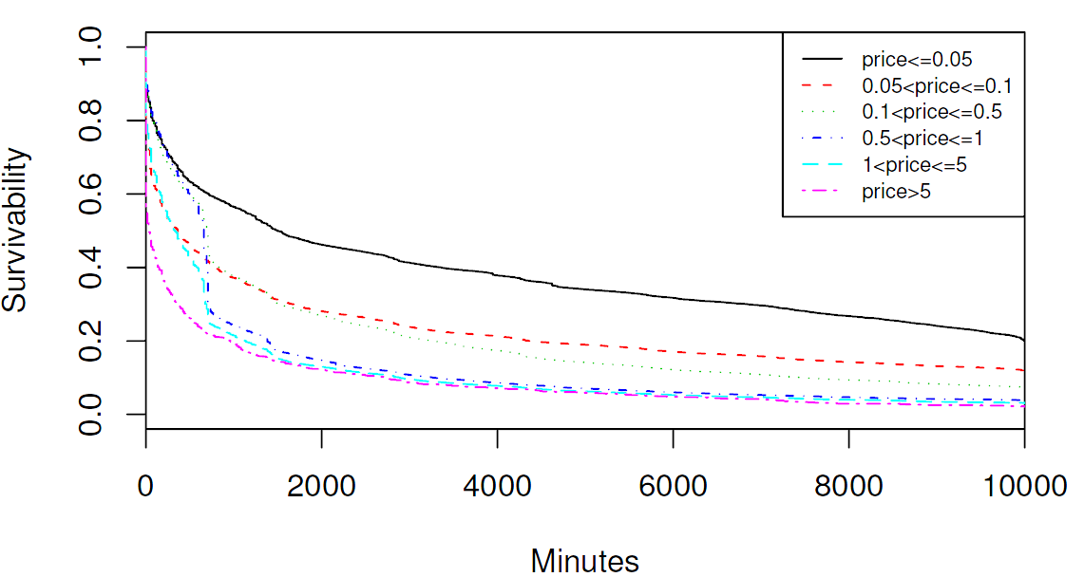
Effect of Price: Mostly monotonic
h(t) = 1.035^price
40% speedup for 10x price
Half-life for $0.025 reward ~ 2 days
Half-life for $1 reward ~ 12 hours
10

Slide 11
Covariates Examined
HIT Characteristics
Monetary reward
Number of HITs
Length in characters
HIT topic (based on Latent Dirichlet Allocation analysis)
Market Characteristics
Day of the week (when HIT was first posted)
Time of the day (when HIT was first posted)
Requester Characteristics
Activities of requester until time of submission
Existing lifetime of requester
11

Slide 12
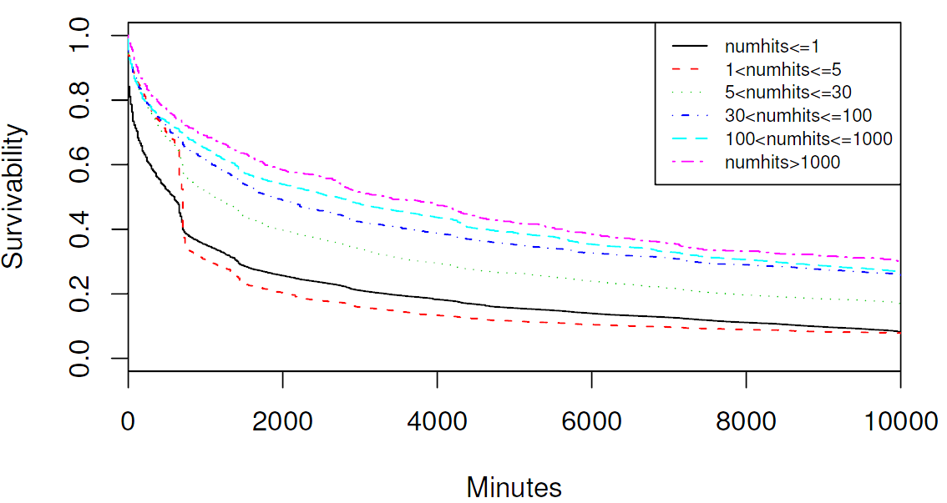
Effect of #HITs: Monotonic, but sublinear
h(t) = 0.998^#HITs
10 HITs → 2% slower than 1 HIT
100 HITs → 19% slower than 1 HIT
1000 HITs → 87% slower than 1 HIT or, 1 group of 1000 → 7 times faster than 1000 sequential groups of 1
12

Slide 13
Covariates Examined
HIT Characteristics
Monetary reward
Number of HITs
Length in characters (increases lifetime)
HIT topic (based on Latent Dirichlet Allocation analysis)
Market Characteristics
Day of the week (when HIT was first posted)
Time of the day (when HIT was first posted)
Requester Characteristics
Activities of requester until time of submission
Existing lifetime of requester
13

Slide 14
HIT Topics
topic 1 : cw castingwords podcast transcribe english mp3 edit confirm snippet grade
topic 2: data collection search image entry listings website review survey opinion
topic 3: categorization product video page smartsheet web comment website opinion
topic 4: easy quick survey money research fast simple form answers link
topic 5: question answer nanonano dinkle article write writing review blog articles
topic 6: writing answer article question opinion short advice editing rewriting paul
topic 7: transcribe transcription improve retranscribe edit answerly voicemail answer
14

Slide 15
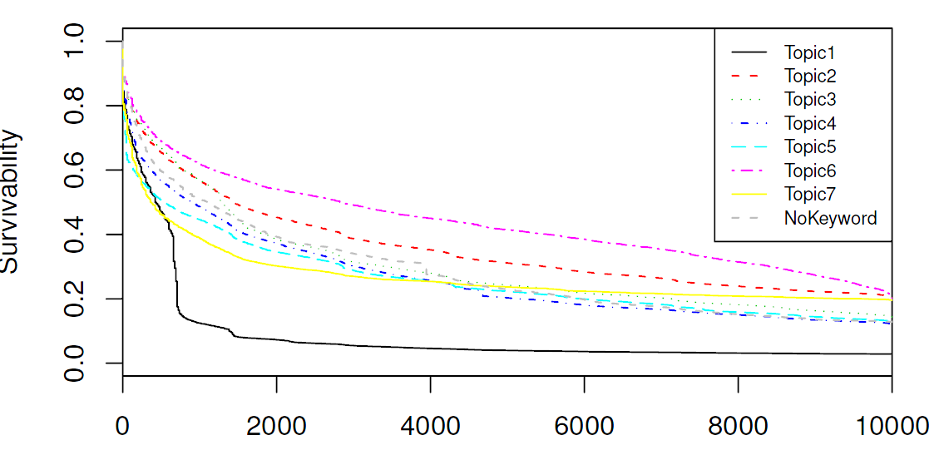
Effect of Topic: The CastingWords Effect
topic 1 : cw castingwords podcast transcribe english mp3 edit confirm snippet grade
topic 2: data collection search image entry listings website review survey opinion
topic 3: categorization product video page smartsheet web comment website opinion
topic 4: easy quick survey money research fast simple form answers link
topic 5: question answer nanonano dinkle article write writing review blog articles
topic 6: writing answer article question opinion short advice editing rewriting paul
topic 7: transcribe transcription improve retranscribe edit answerly voicemail query question answer
15

Slide 16
Effect of Topic: Surveys=fast (even with redundancy!)
topic 1 : cw castingwords podcast transcribe english mp3 edit confirm snippet grade
topic 2: data collection search image entry listings website review survey opinion
topic 3: categorization product video page smartsheet web comment website opinion
topic 4: easy quick survey money research fast simple form answers link
topic 5: question answer nanonano dinkle article write writing review blog articles
topic 6: writing answer article question opinion short advice editing rewriting paul
topic 7: transcribe transcription improve retranscribe edit answerly voicemail query question answer
16

Slide 17
Effect of Topic: Writing takes time
topic 1 : cw castingwords podcast transcribe english mp3 edit confirm snippet grade
topic 2: data collection search image entry listings website review survey opinion
topic 3: categorization product video page smartsheet web comment website opinion
topic 4: easy quick survey money research fast simple form answers link
topic 5: question answer nanonano dinkle article write writing review blog articles
topic 6: writing answer article question opinion short advice editing rewriting paul
topic 7: transcribe transcription improve retranscribe edit answerly voicemail query question answer
17

Slide 18
Covariates Examined
HIT Characteristics
Monetary reward
Number of HITs
Length in characters (increases lifetime)
HIT topic (based on Latent Dirichlet Allocation analysis)
Market Characteristics: Not affecting
Day of the week (when HIT was first posted)
Time of the day (when HIT was first posted)
Requester Characteristics
Activities of requester until time of submission
Existing lifetime of requester (1yr ~ 50% speedup)
18

Slide 19
Covariates Examined
HIT Characteristics
Monetary reward
Number of HITs
Length in characters (increases lifetime)
HIT topic (based on Latent Dirichlet Allocation analysis)
Market Characteristics: Not affecting
Day of the week (when HIT was first posted)
Time of the day (when HIT was first posted)
Requester Characteristics
Activities of requester until time of submission
Existing lifetime of requester
Why? We look at long-running HITs until completion…
19

Slide 20
Covariates Examined
HIT Characteristics
Monetary reward
Number of HITs
Length in characters (increases lifetime)
HIT topic (based on Latent Dirichlet Allocation analysis)
Market Characteristics: Not affecting
Day of the week (when HIT was first posted)
Time of the day (when HIT was first posted)
Requester Characteristics
Activities of requester until time of submission
Existing lifetime of requester (1yr ~ 50% speedup)
20

Slide 21
Conclusions
Completion times for tasks in Amazon Mechanical Turk follow a heavy tail distribution. (Paper studying MicroTasks.com has similar conclusions.)
Sample averages cannot be used to predict the expected completion time of a task.
By fitting a Cox proportional hazards regression model to the data collected from AMT, we showed the effect of various HIT parameters in the completion time of the task
“Base survival function” still a power-law ➔ Still difficult to predict
21

Slide 22
Lessons Learned and Future Work
Current survival analysis too naive:
Ignores many interactions across variables
Need time-dependent covariates (market changes over time)
More frequent crawling does not change the results
Important: Analysis ignores “refilling” of HITs
TODO:
Better to model directly the HIT assignment disappearance rate (how many #HITs done per minute)
Use queuing model theories
Use hierarchical version of LDA and dynamic models (#topics and shifts in topics over time)
22

Slide 23
Any Questions?

