Slide 1
Collective Problem Solving in Networks
Winter Mason and Duncan J. Watts

Slide 2
Financial Incentives in Crowdsourcing
(or, How I Learned to Love Mechanical Turk)

Slide 3
Financial Incentives and Performance
Intuitive Hypothesis:
Greater pay will lead to more and better work
Support from:
Rational economic theory
Classic Mgmt Sci studies (Lazear, 1998)
CEO incentives
Conflicting evidence:
Intrinsic motivation undermined by extrinsic motivation (Deci & Ryan, 1972)
Contingency on pay, when value is high, can lead to ‘choking’ (Ariely, Gneezy, Lowenstein, & Mazar)
Risk aversion (Herzberg, 1987)

Slide 4
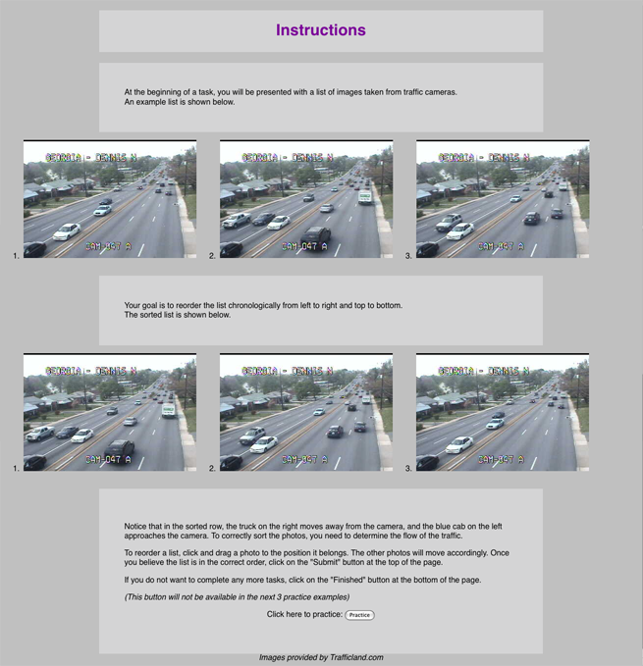
Study 1: Traffic Images
Manipulated
Task Value
Amount earned per image set
$0.01, $0.05, $0.10
No additional pay for image sets
Difficulty
Number of images per set
2, 3, 4
Measured
Quantity
Number of image sets submitted
Quality
Proportion of image sets correctly sorted
Rank correlation of image sets with correct order

Slide 5
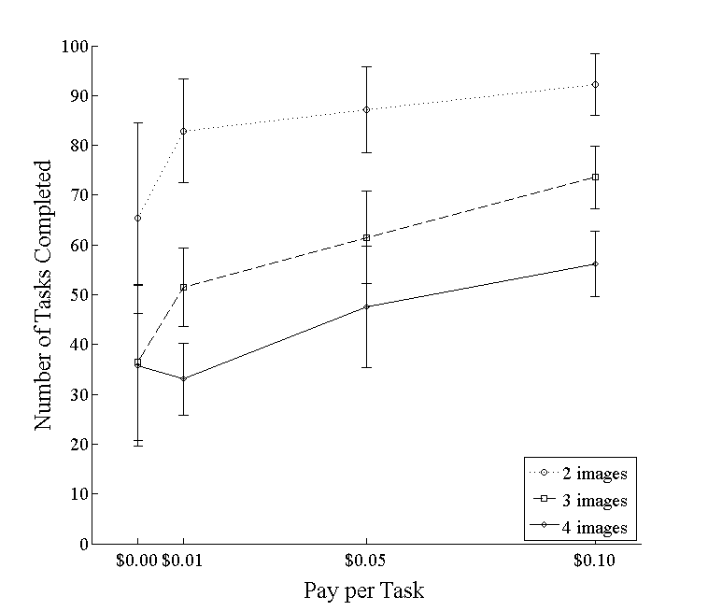
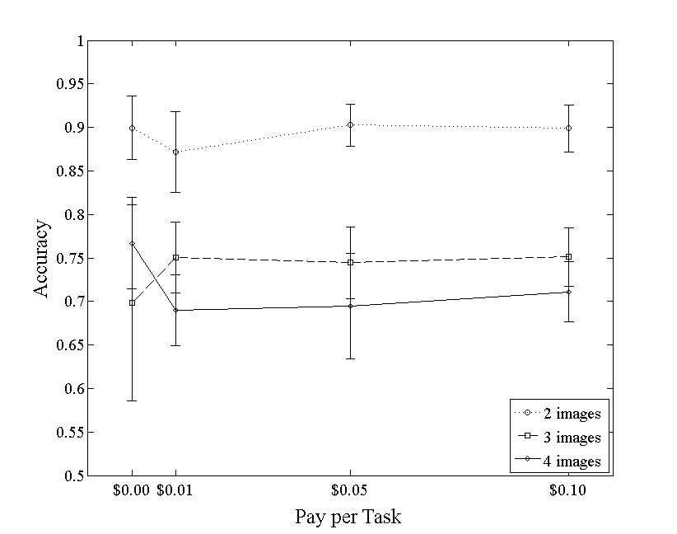
How Much to Pay?
Pay rate can affect quantity of work
Pay rate does not have a big impact on quality
(MW ’09)

Slide 6
Collective Problem Solving

Slide 7
Exploration vs. Exploitation
Exploration/Exploitation represents a fundamental tradeoff in complex optimization problems in CS and Stat Mech:
MCMC = hill-climbing (exploit) + random jumps (explore)
Also true of human/organizational learning, where exploration and exploitation are both required, and compete for resources
Rational Search (e.g. Radner)
N projects with unknown payoffs distributions
Must choose between learning current distribution vs. exploring new ones
Boundedly Rational Search
Like above, but with cognitive biases
Satisficing (Simon)
Prospect Theory (Kahneman and Tversky)
Organizational Learning (March 1991)
Refinement vs. Invention
Basic Science vs. Development
Evolutionary Models (in particular, of organizations)
Variation vs. Selection (Hannan and Freeman)

Slide 8
Collective Problem Solving
Exploration / exploitation tradeoff is more complex when multiple agents are sharing information about problem space
Can accelerate learning, by sharing good solutions
But can lead to premature convergence on suboptimal solution

Slide 9
Our Project
Substantive Questions
How do individuals collaboratively solve (certain kinds of) “complex” problems?
How does the structure of the communication network between them contribute to their collective performance?
How does individual position in the network relate to
Individual strategy and performance?
Collective performance?
Our approach so far has been experimental
Human participants recruited through Amazon’s Mechanical Turk (AMT)

Slide 10
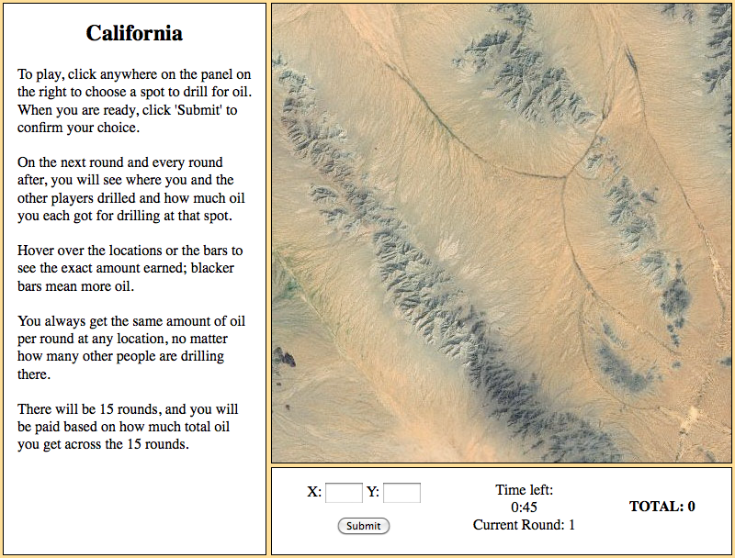

Slide 11
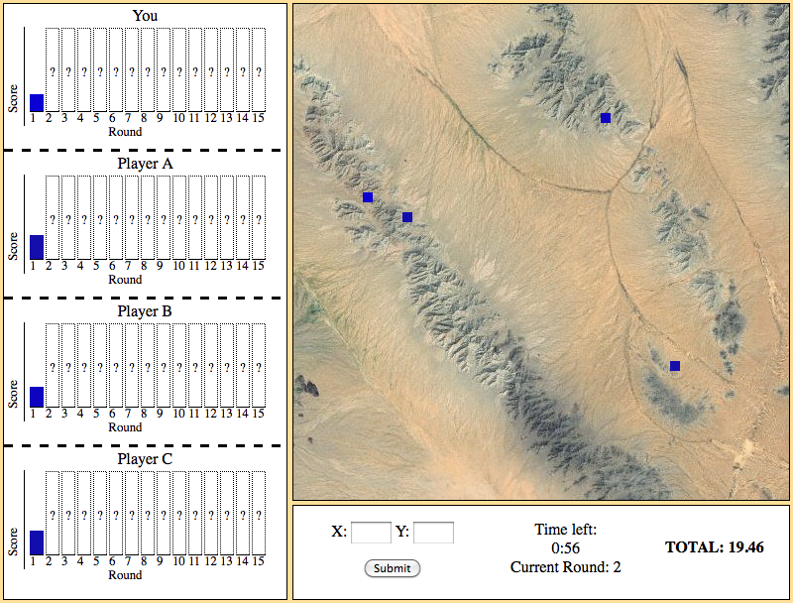

Slide 12
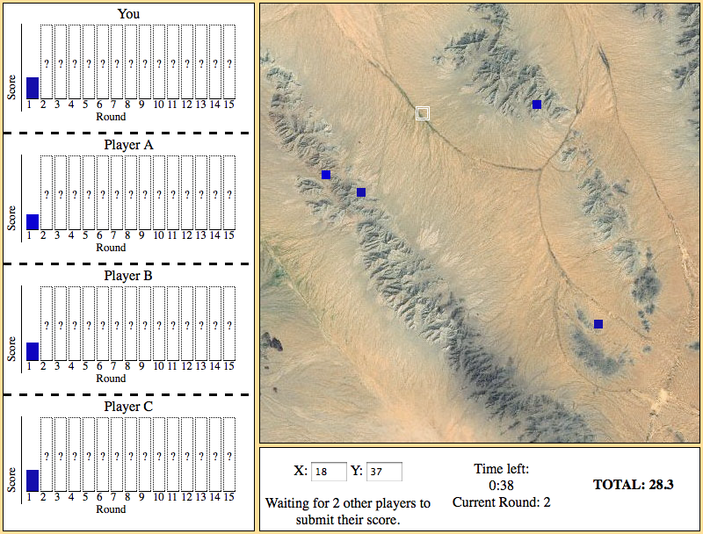

Slide 13
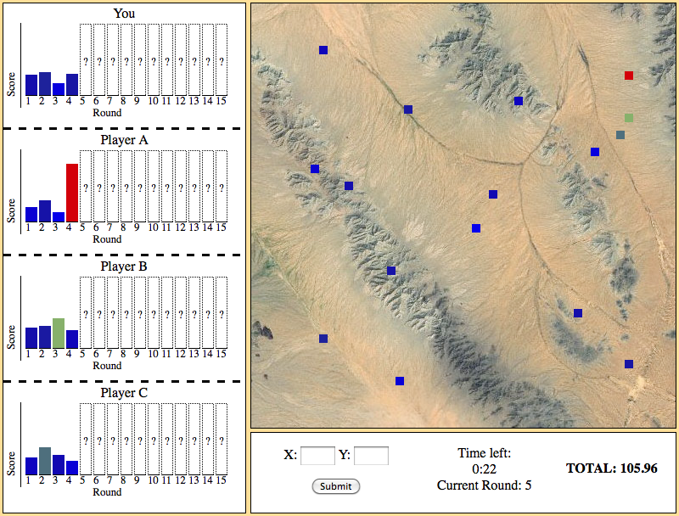

Slide 14
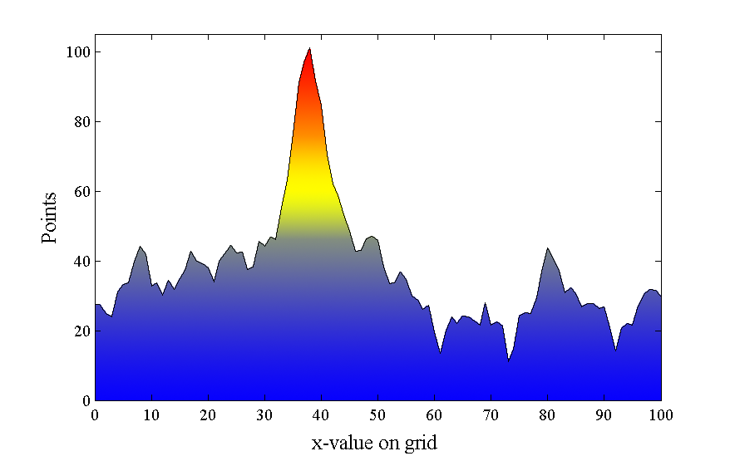
Payoff Functions
Background generated with 4-octave Perlin noise
Added to a unimodal Gaussian function with mean chosen uniformly at random and SD = 3
Normalized so maximum points = 100

Slide 15
Constructing Communication Networks
Goal: 16-node fixed-degree graphs with extreme statistics
Start with fixed-degree random graphs
All players have same amount of information
Only position in graph can affect success
Rewire to increase or decrease some graph feature
Maximum, Average, Variance
Betweenness, Closeness, Clustering, Network Constraint
Ensuring connected graph
Stop when no rewiring improves feature
Repeat 100 times, keep maximal graph

Slide 16
Features
Clustering:
Number of connected neighbors / Possibly connected neighbors
Betweenness
Number of shortest paths through node
Closeness
Average shortest path to all nodes
Network Constraint
Redundancy with neighbors

Slide 17
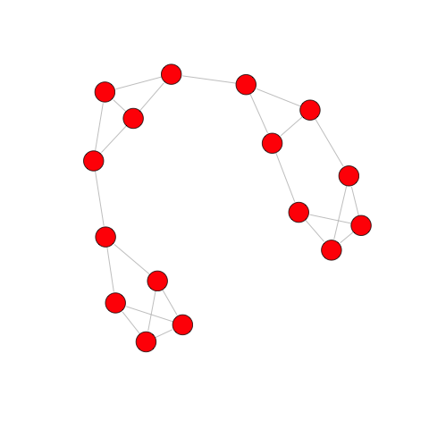
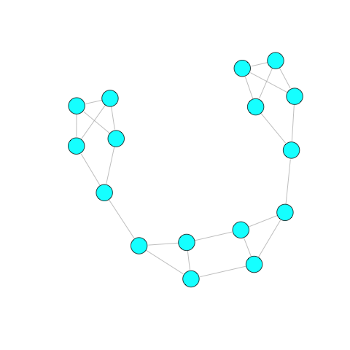
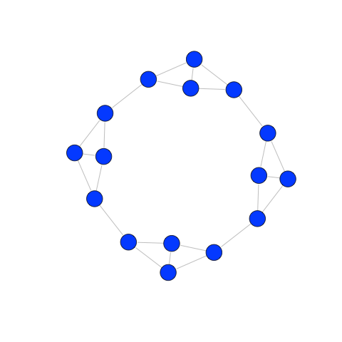
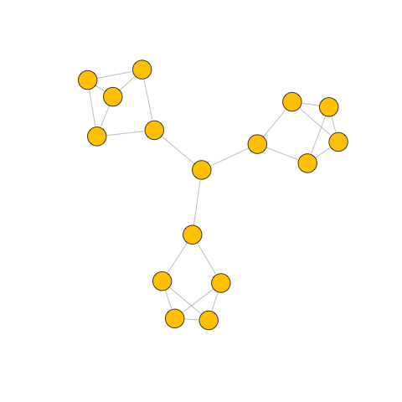
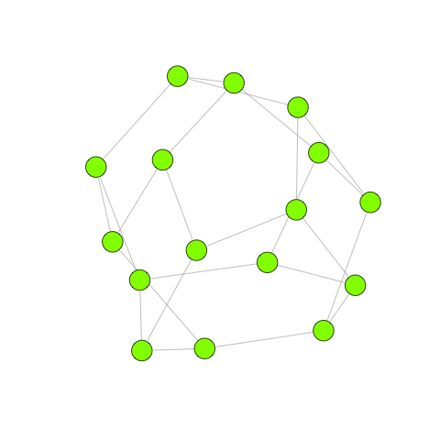
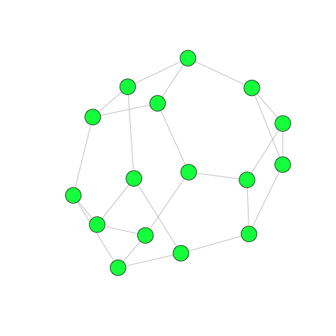
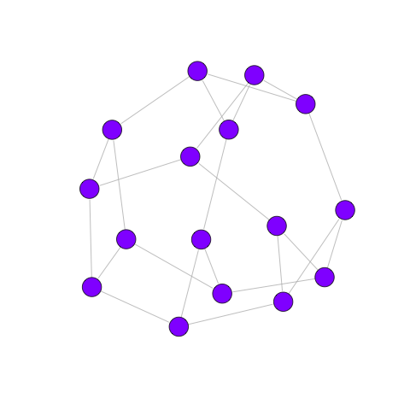
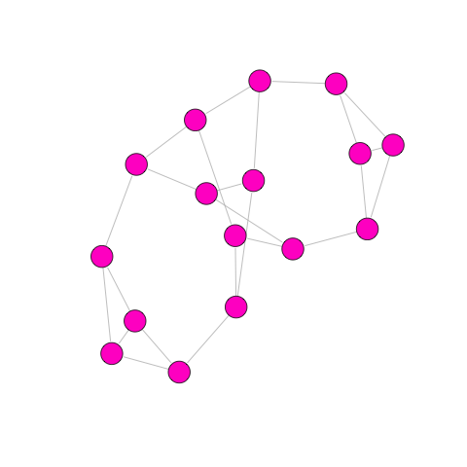
Communication Networks
Greatest Average Betweenness
Smallest Maximum Closeness
Greatest Average Clustering
Greatest Maximum Betweenness
Smallest Average Betweenness
Greatest Maximum Closeness
Smallest Average Clustering
Greatest Variance in Constraint

Slide 18
Experiments
For each session, 16 subjects are recruited from MTurk
Standing panel alerted previous day
Accept work & read instructions
Sit in “waiting room” until enough players have joined
Each session comprises 8 games
One for each network topology
Each game runs for 15 rounds
100 x100 grid
Relative dimensions of peak and landscape adjusted such that peak is found sometimes, but not always
171 out of total of 232 games (25 sessions) used
61 games removed because player dropped out
Notes:
Note mturk methods paper here

Slide 19
Preview of Results
Network structure affects individual search strategy
Individual search strategy affects group success
Network structure affects group success
Individual and group performance are in tension

Slide 20
Network structure affects individual search strategy
Networks differ in amount of exploration
Related to clustering

Slide 21
Network structure affects individual search strategy
Higher clustering
⬇
Higher probability of neighbors guessing in identical location
More neighbors guessing in identical location
⬇
Higher probability of copying

Slide 22
Individual search strategy affects group success
More players copying each other (i.e., fewer exploring) in current round
⬇
Lower probability of finding peak on next round

Slide 23
Individual search strategy affects group success
No significant differences in % of games in which peak was found
But pattern similar to differences in exploration

Slide 24
Communication Networks
Greatest Average Betweenness
Smallest Maximum Closeness
Greatest Average Clustering
Greatest Maximum Betweenness
Smallest Average Betweenness
Greatest Maximum Closeness
Smallest Average Clustering
Greatest Variance in Constraint

Slide 25
Network structure affects group success

Slide 26
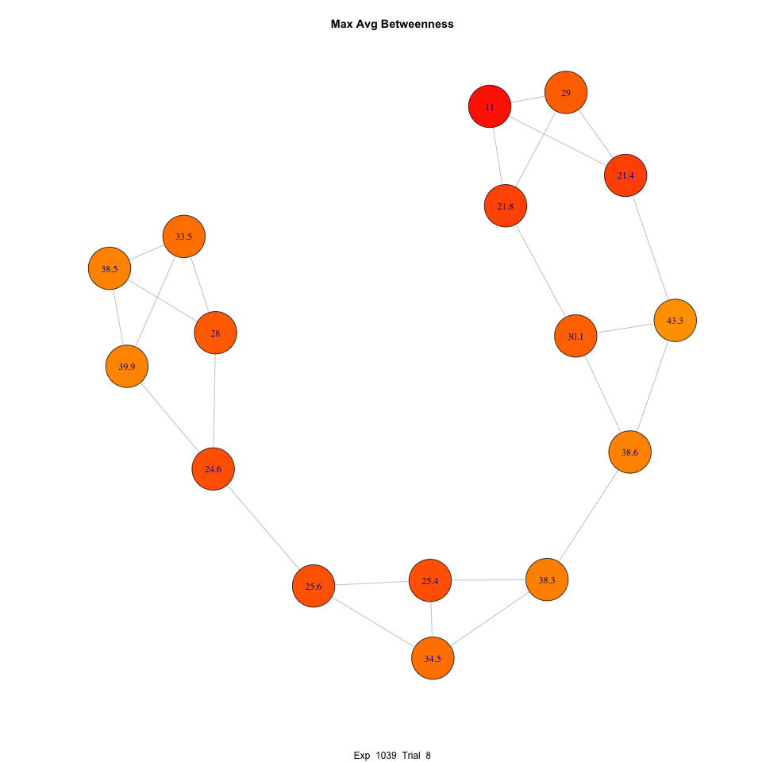
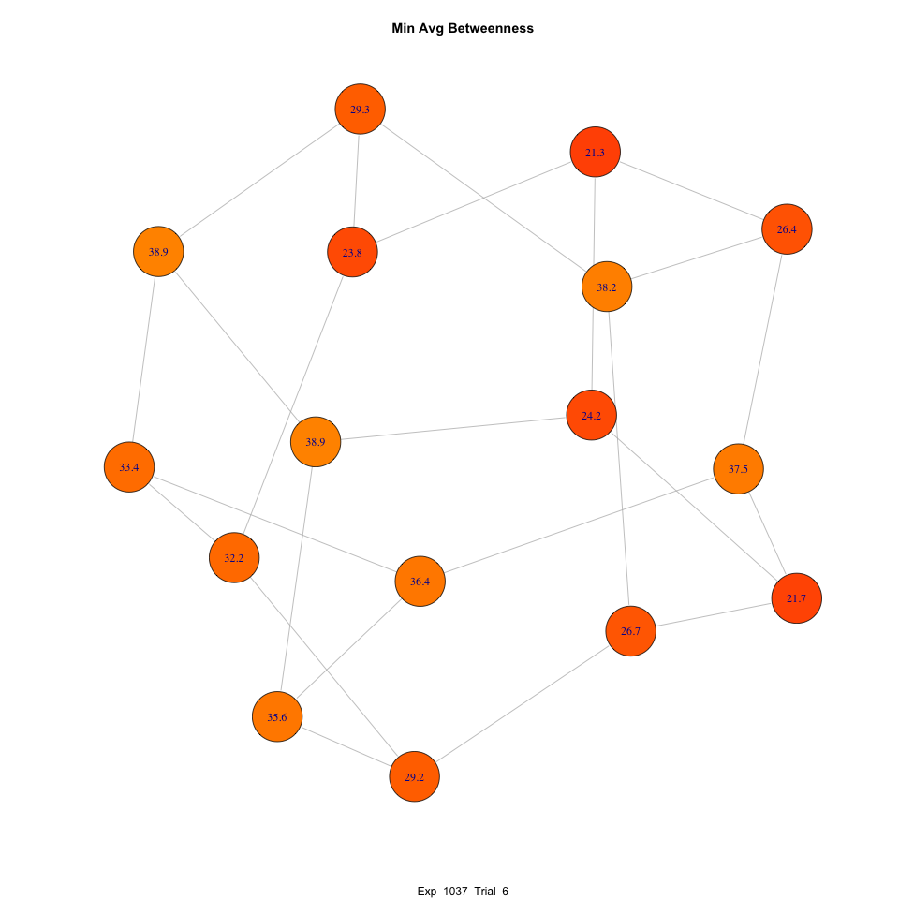
Diffusion of Best Solution

Slide 27
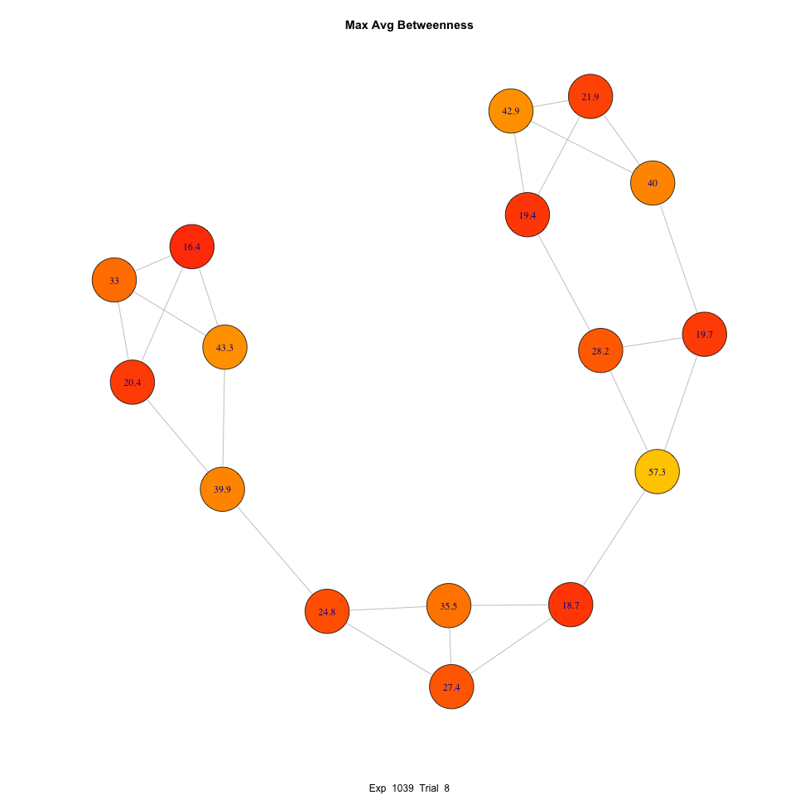
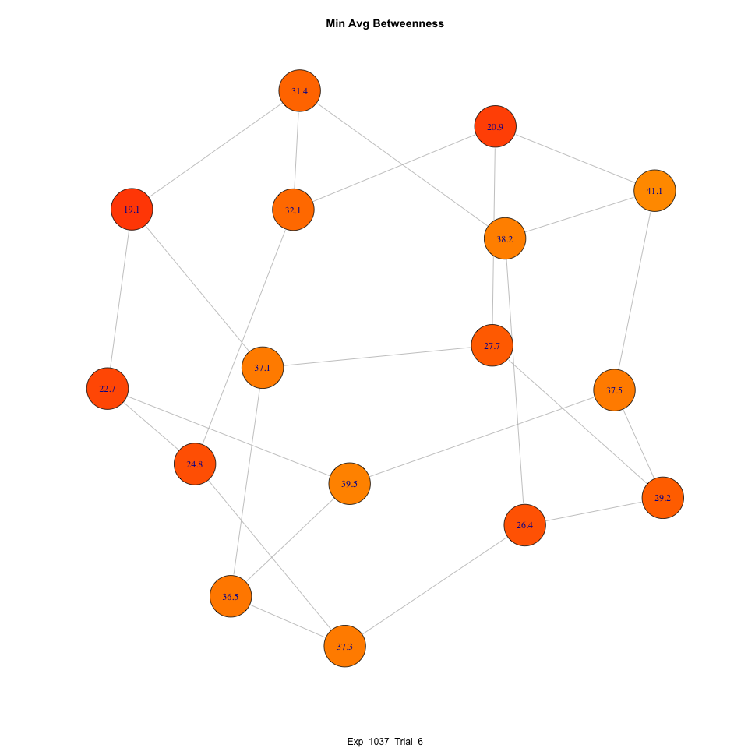
Diffusion of Best Solution

Slide 28
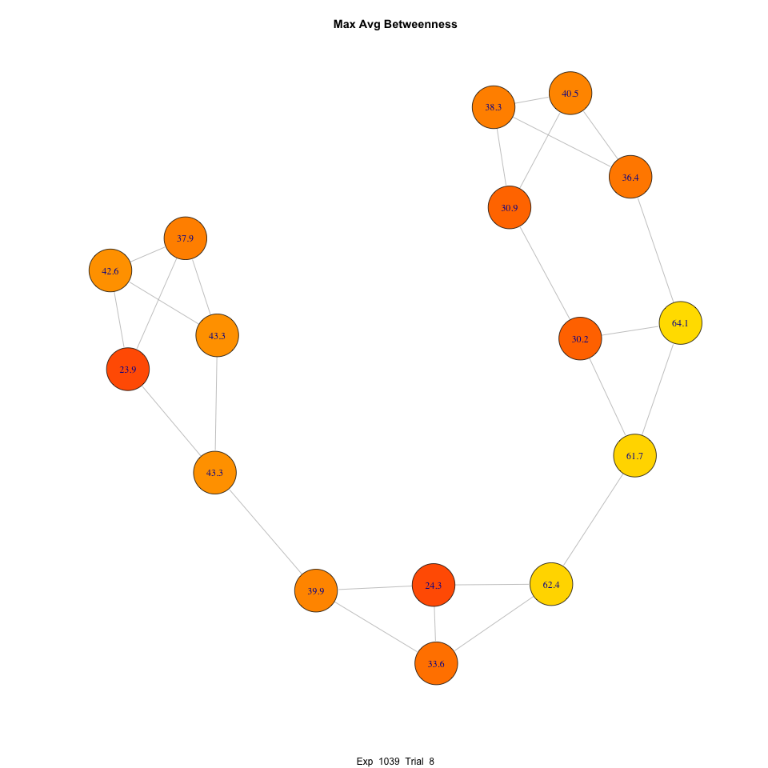
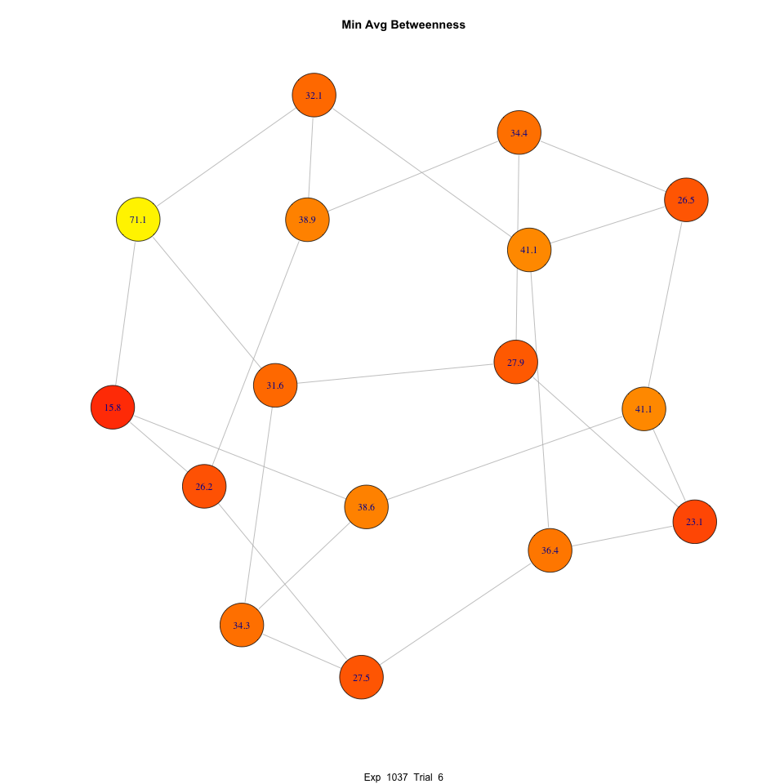
Diffusion of Best Solution

Slide 29
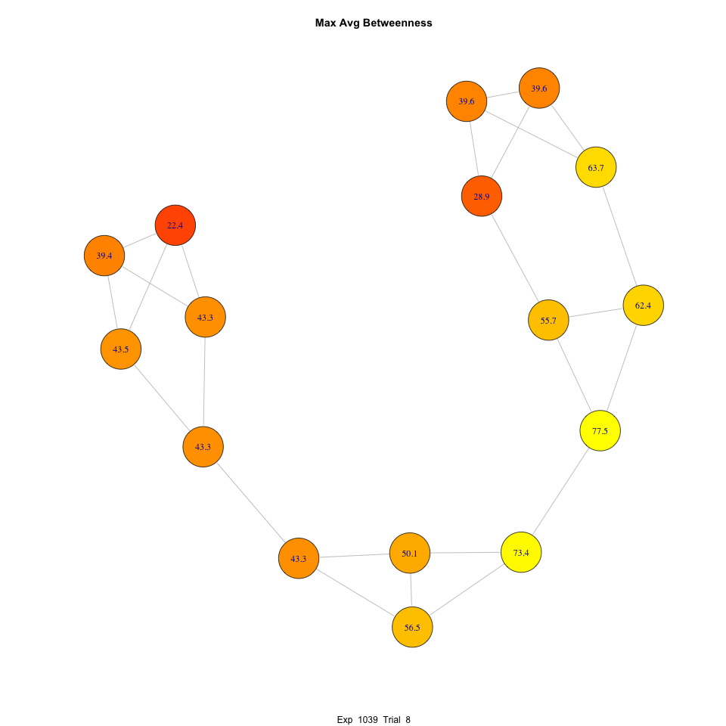
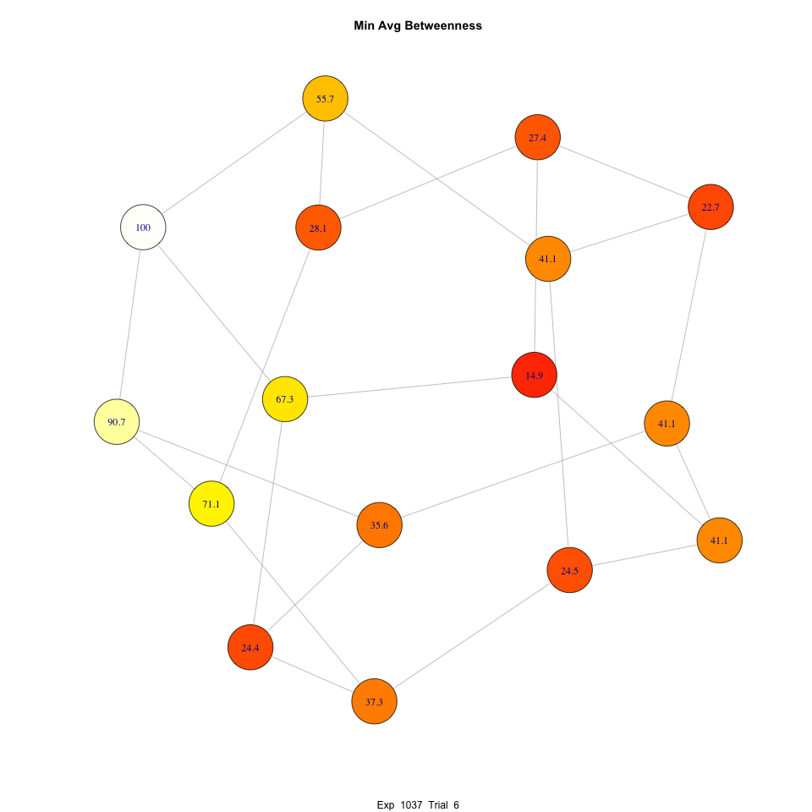
Diffusion of Best Solution

Slide 30
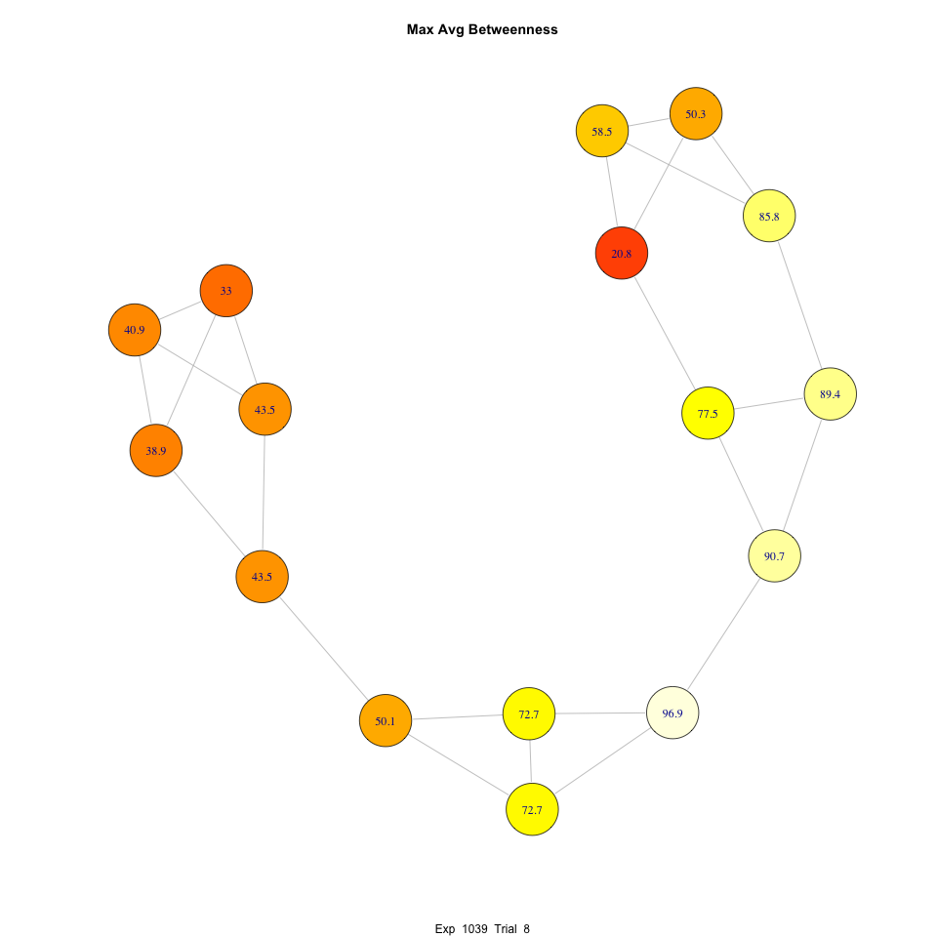
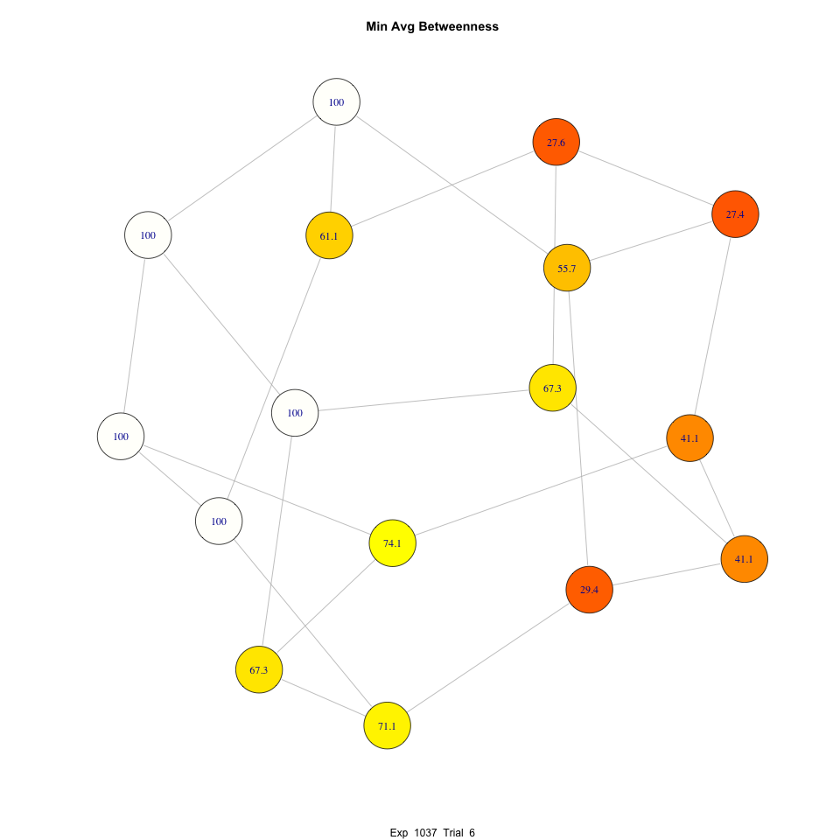
Diffusion of Best Solution

Slide 31
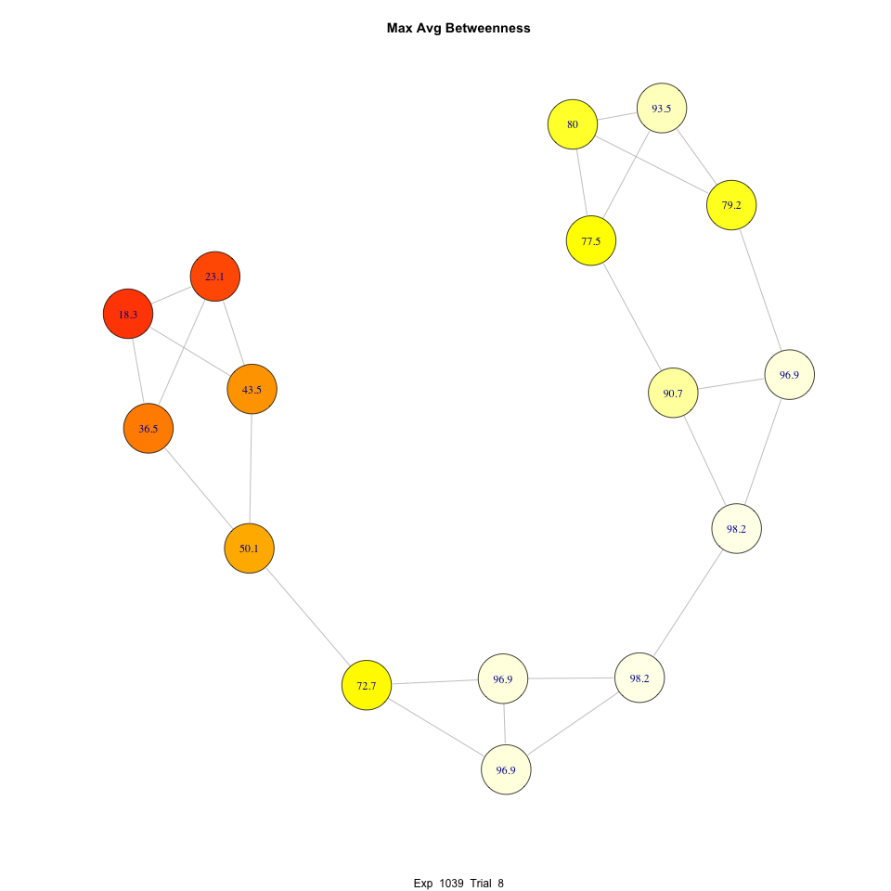
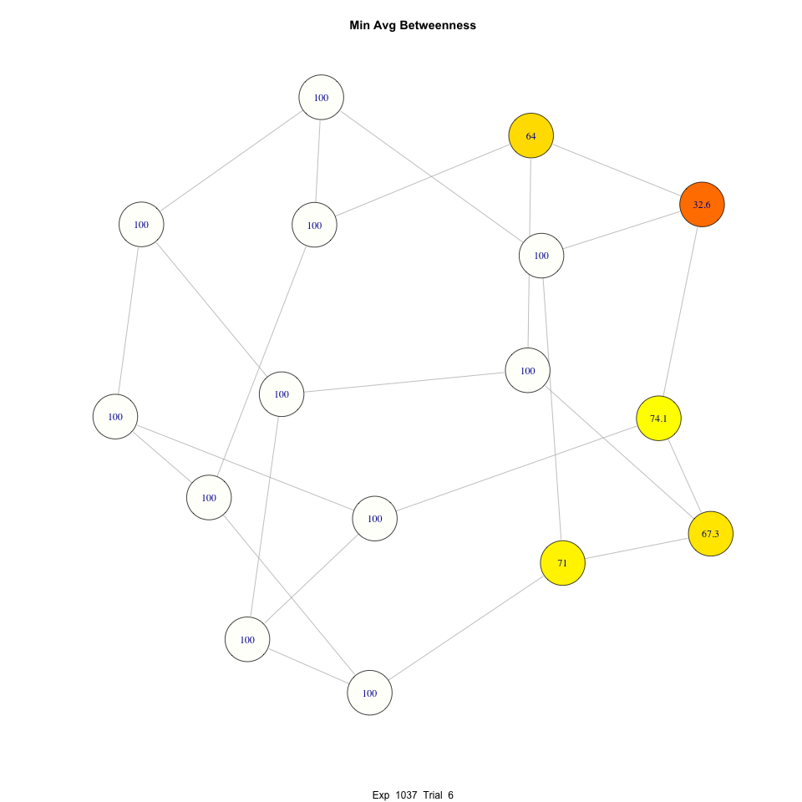
Diffusion of Best Solution

Slide 32
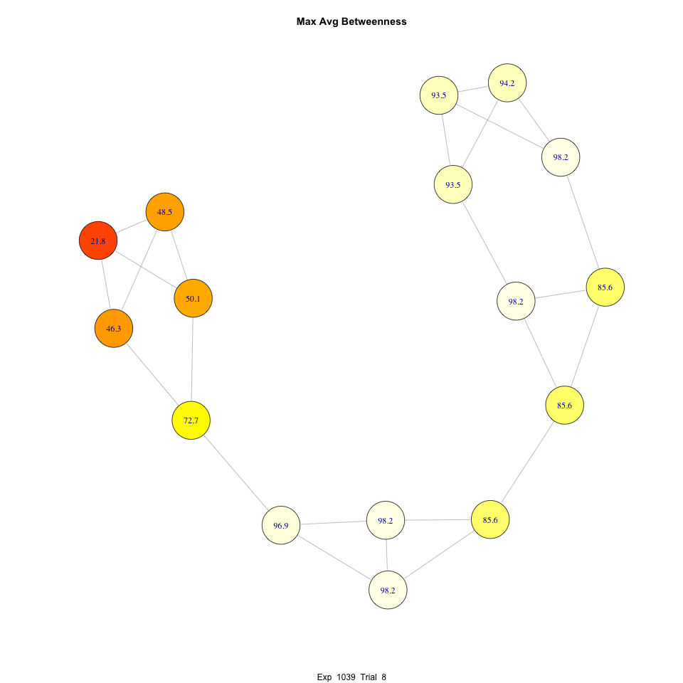
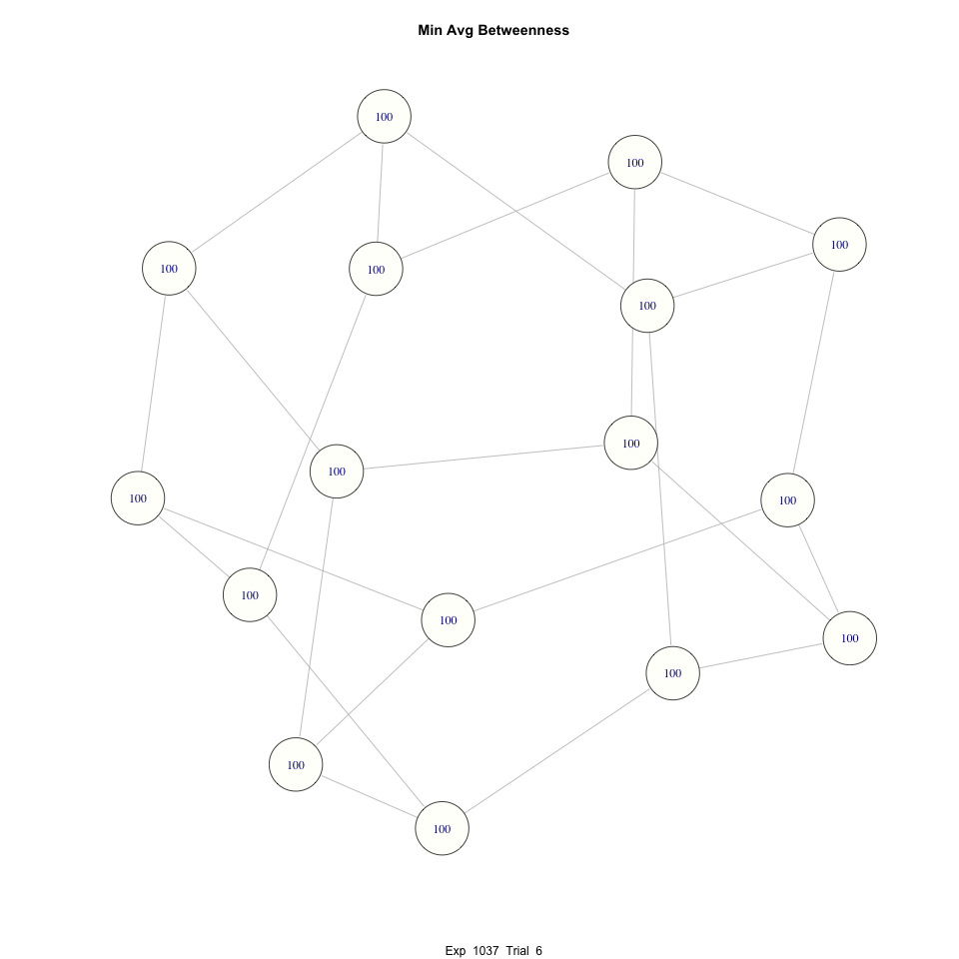
Diffusion of Best Solution

Slide 33
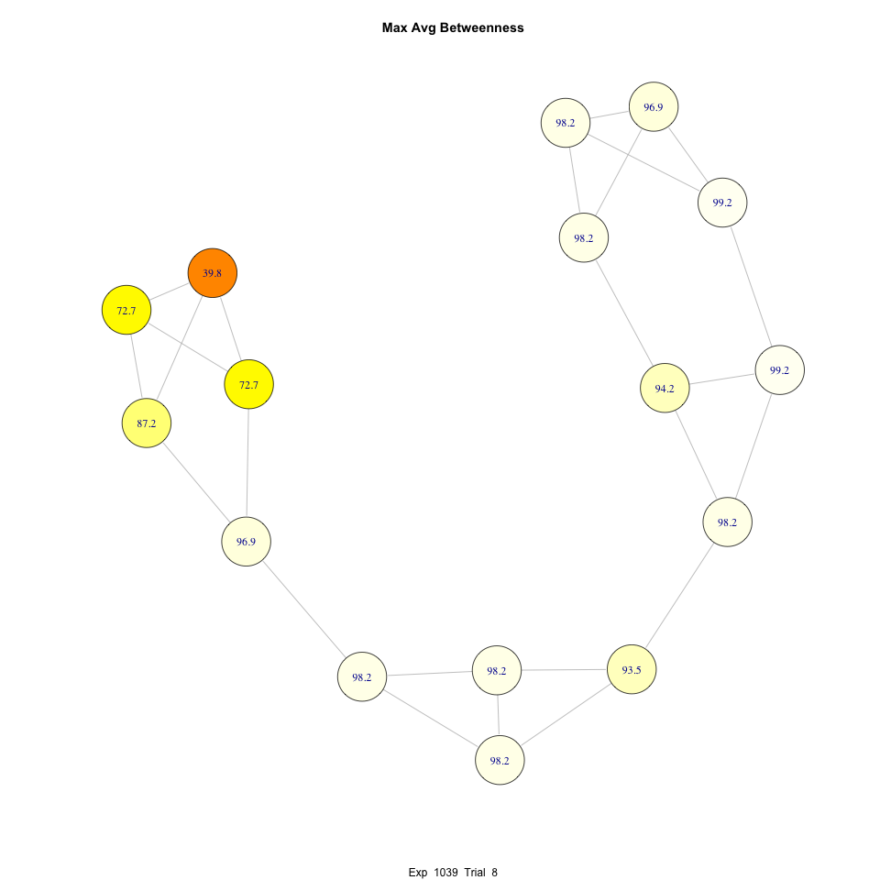
Diffusion of Best Solution

Slide 34
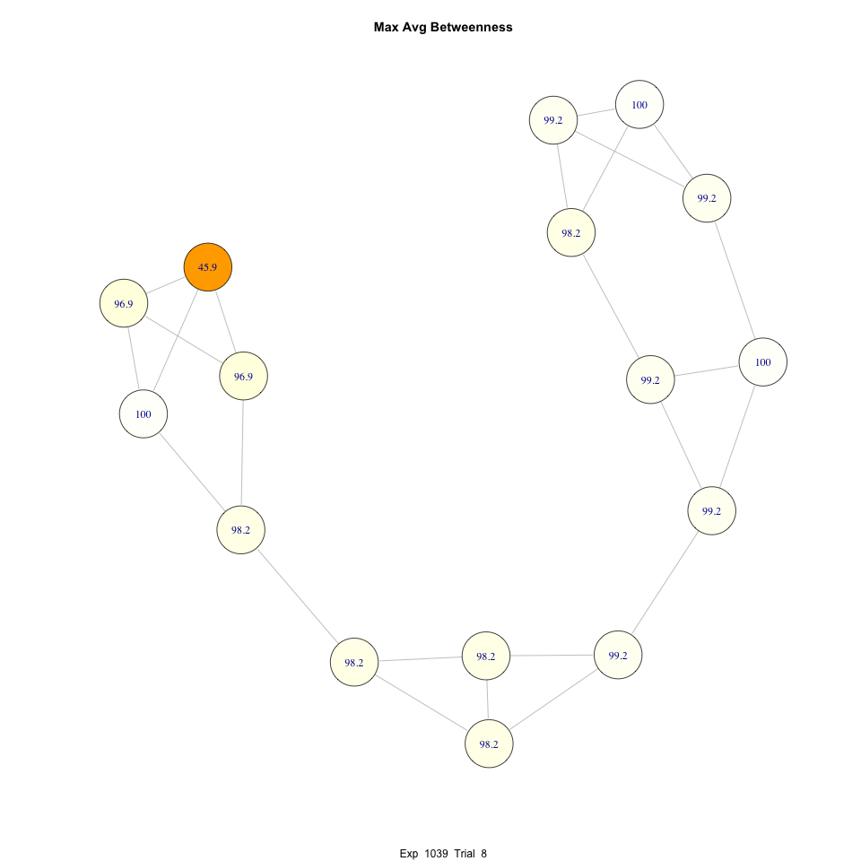
Diffusion of Best Solution

Slide 35
Individual and group performance are in tension
More likely to find peak with more players exploring (= fewer players copying)
When peak is found, large difference in points (nearly 2x income)

Slide 36
Individual and group performance are in tension
BUT
Per player, higher points on average with “copying” strategy
= free-riding problem / social dilemma

Slide 37
Individual and group performance are in tension
Most successful node in structured networks ~ performance of median node in unstructured networks

Slide 38
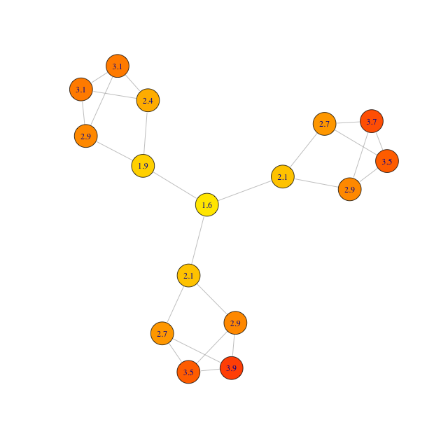
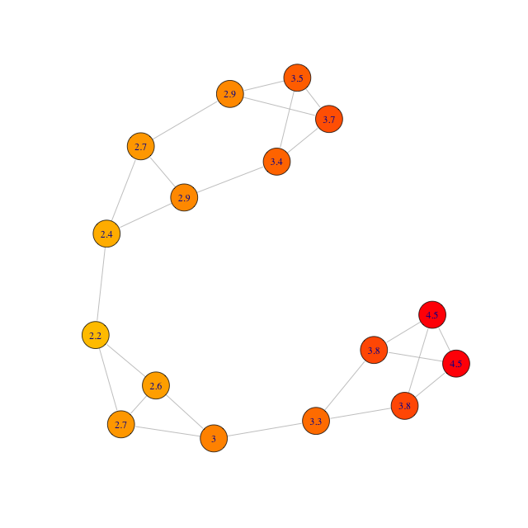
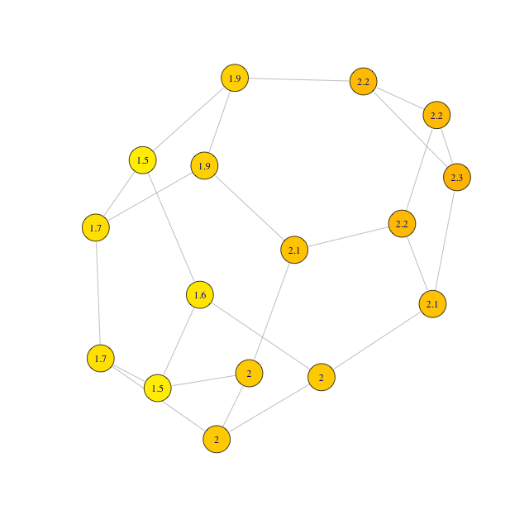
Individual Performance Is Combination of Individual Position and Collective Performance
Greatest Maximum Betweenness
Greatest Average Betweenness
Greatest Maximum Closeness

Slide 39
Summary of Results
Network structure affects individual search strategy
Clustering increases copying (exploitation)
Individual search strategy affects group success
More copying means lower probability of finding maximum
Network structure affects group success
Networks with lower average path length spread information more quickly
Individual and group performance are in tension
Individuals can improve own relative performance by free-riding on others’ exploration
Best position in structured networks as good as average position in unstructured networks

Slide 40
Thank you!
Questions?

