Slide 1
You’re Hired! An Examination of Crowdsourcing Incentive Models in Human Resource Tasks
Christopher Harris
Informatics Program
The University of Iowa
Workshop on Crowdsourcing for Search and Data Mining (CSDM 2011)
Hong Kong, Feb. 9, 2011

Slide 2
Overview
Background & motivation
Experimental design
Results
Conclusions & Feedback
Future extensions

Slide 3
Background & Motivation
Technology gains not universal
Repetitive subjective tasks difficult to automate
Example: HR resume screening
Large number of submissions
Recall important, but precision
important too
Semantic advances help,
but not the total solution

Slide 4
Needles in Haystacks
Objective – reduce a pile of 100s of resumes to a list of those deserving further consideration
Cost
Time
Correctness
Good use of
crowdsourcing?

Slide 5
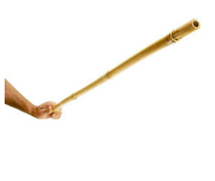
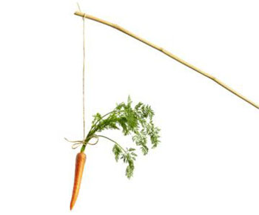
Underlying Questions
Can a high-recall event, such as resume screening, be crowdsourced effectively?
What role do positive and negative incentives play in accuracy of ratings?
Do workers take more time to complete HITs when accuracy is being evaluated?

Slide 6
Experimental Design
Set up collections of HITs (Human Intelligence Tasks) on Amazon Mechanical Turk
Initial screen for English comprehension
Screen participants for attention to detail on the job description (free text entry)

Slide 7
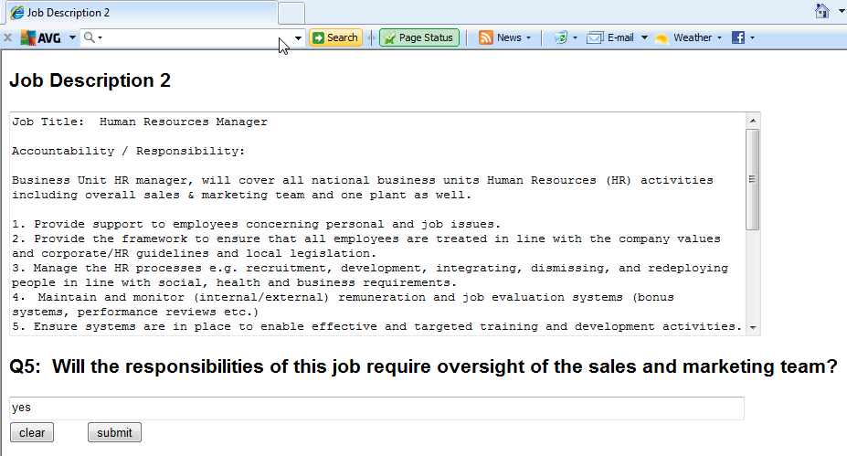
Attention to Detail Screening

Slide 8
Baseline – No Incentive
Start with 3 job positions
Each position with 16 applicants
Pay is $0.06 per HIT
Rate resume-job application fit on scale of 1 (bad match) to 5 (excellent match)
Compare to Gold Standard rating

Slide 9
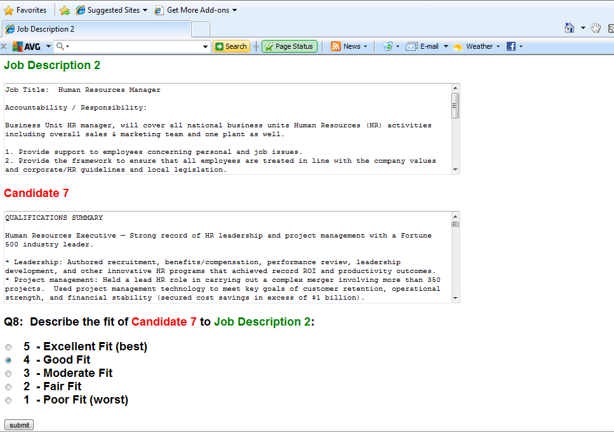

Slide 10
Experiment 1 – Positive Incentive
Same 3 job positions
Same number of applicants (16) per position & base pay
Rated application fit on same scale of 1 to 5
Compare to Gold Standard rating
If same rating as GS, double money for that HIT ( 1-in-5 chance if random)
If no match, still get standard pay for that HIT

Slide 11
Experiment 2 – Negative Incentive
Same 3 job positions
Again, same no of applicants per position & base pay
Rated application fit on same scale of 1 to 5
Compare to Gold Standard rating
No positive incentive - if same rating as our GS, get standard pay for that HIT, BUT…
If more than 50% of ratings don’t match, Turkers paid only 0.03 per HIT for all incorrect answers!

Slide 12
Experiment 3 – Pos/Neg Incentives
Same 3 job positions
Again, same no of applicants per position & base pay
Rated application fit on same scale of 1 to 5
Compare to Gold Standard rating
If same rating as our GS, double money for that HIT
If not, still get standard pay for that HIT, BUT…
If more than 50% of ratings don’t match, Turkers paid only 0.03 per HIT for all incorrect answers!

Slide 13
Experiments 4-6 – Binary Decisions
Same 3 job positions
Again, same no of applicants per position & base pay
Rated fit on a binary scale (Relevant/Non-relevant)
Compare to Gold Standard rating
GS rated 4 or 5 = Relevant,
GS rated 1-3 = Not Relevant
Same incentive models apply as in Exp 1-3
Baseline, no incentive - Exp 5, neg incentive
Exp 4, pos incentive - Exp 6, pos/neg incentive

Slide 14
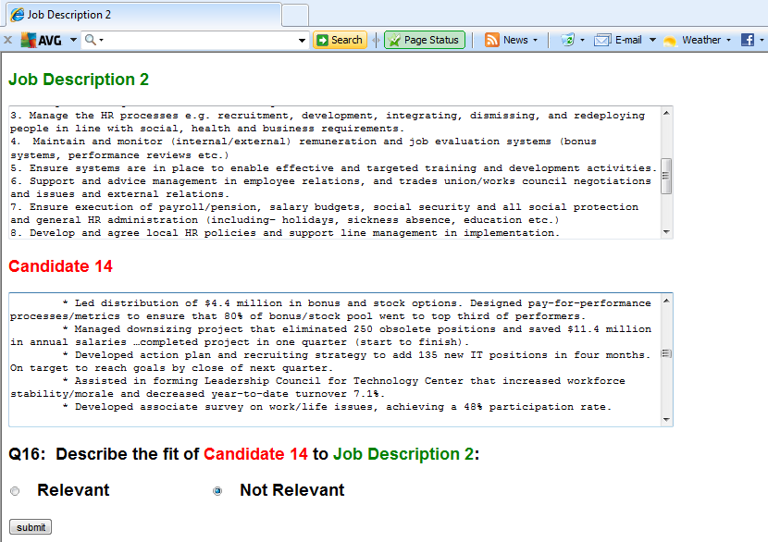

Slide 15
Results

Slide 16
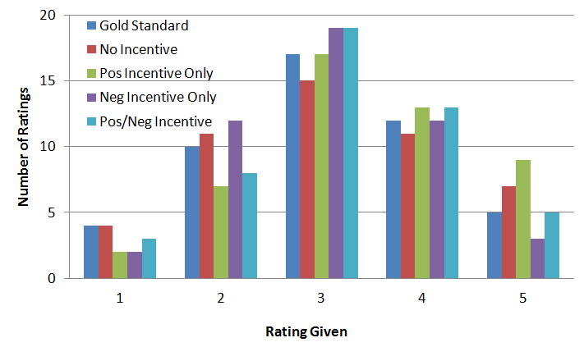
Ratings
Pos Incentive skewed right
Neg Incentive has smallest σ
No Incentive has largest σ

Slide 17
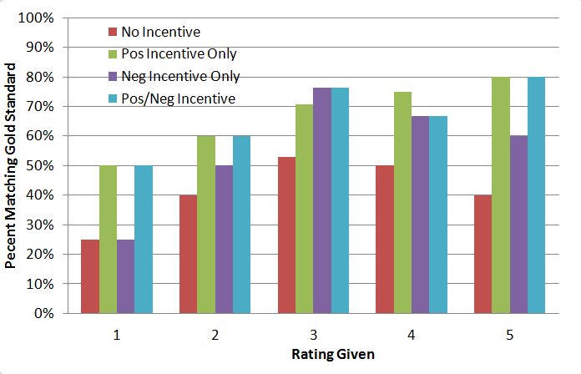
Percent Match

Slide 18
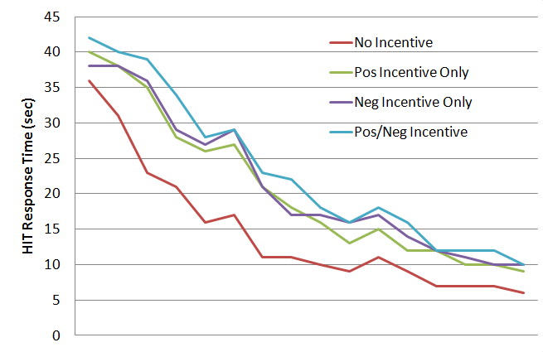
Time Taken Per HIT
Attention to Detail Checks

Slide 19
Binary Decisions
 | expert
Baseline |  | accept | reject
 | accept | 8 | 16 | 24
 | reject | 9 | 15 | 24
 |  | 17 | 31 | 48
 | expert
pos |  | accept | reject
 | accept | 14 | 7 | 21
 | reject | 3 | 24 | 27
 |  | 17 | 31 | 48
 | expert
neg |  | accept | reject
 | accept | 13 | 11 | 24
 | reject | 6 | 18 | 24
 |  | 19 | 29 | 48
 | expert
pos/neg |  | accept | reject
 | accept | 14 | 4 | 18
 | reject | 3 | 27 | 30
 |  | 17 | 31 | 48

Slide 20
Binary Overall Results
 | Precision | Recall | F-score
Baseline | 0.33 | 0.47 | 0.39
Pos | 0.67 | 0.82 | 0.74
Neg | 0.54 | 0.68 | 0.60
Pos/Neg | 0.78 | 0.82 | 0.80

Slide 21
Conclusions
Incentives play a role in crowdsourcing performance
More time taken
More correct answers
Answer skewness
Better for recall-oriented tasks than precision-oriented tasks

Slide 22
Afterthoughts
Anonymizing the dataset takes time
How long can “fear of the oracle” exist?
Can we get reasonably good results with few participants?
Are cultural and group preferences may differ from those of HR screeners?
Can more training help offset this?

Slide 23
Participant Feedback
“A lot of work for the pay”
“A lot of scrolling involved, which got tiring”
“Task had a clear purpose”
“Wished for faster feedback on [incentive matching]”

Slide 24
Next Steps
Examine pairwise preference models
Expand on incentive models
Limit noisy data
Compare with machine learning methods
Examine incentive models in GWAP

Slide 25
Thank you. Any questions?

